Slide 1


SQL Saturday 864
South Florida, United Sates
June 8, 2019
Hiram Fleitas
Fleitas Arts
github.com/hfleitas/Pixies
Notes:
Image ref: https://img-prod-cms-rt-microsoft-com.akamaized.net/cms/api/am/imageFileData/RE2ZsFd
https://www.microsoft.com/en-us/ai/business

Slide 2
Hack / Protect SQL Server
Learn Both
Tabular Data Stream
Load Test
Dynamic Data Masking
Row-Level Security
Hiram Fleitas
Fleitas Arts
github.com/hfleitas/Pixies
Notes:
Image ref: https://img-prod-cms-rt-microsoft-com.akamaized.net/cms/api/am/imageFileData/RE2ZsFd
https://www.microsoft.com/en-us/ai/business

Slide 3


Please silence cell phones

Slide 4
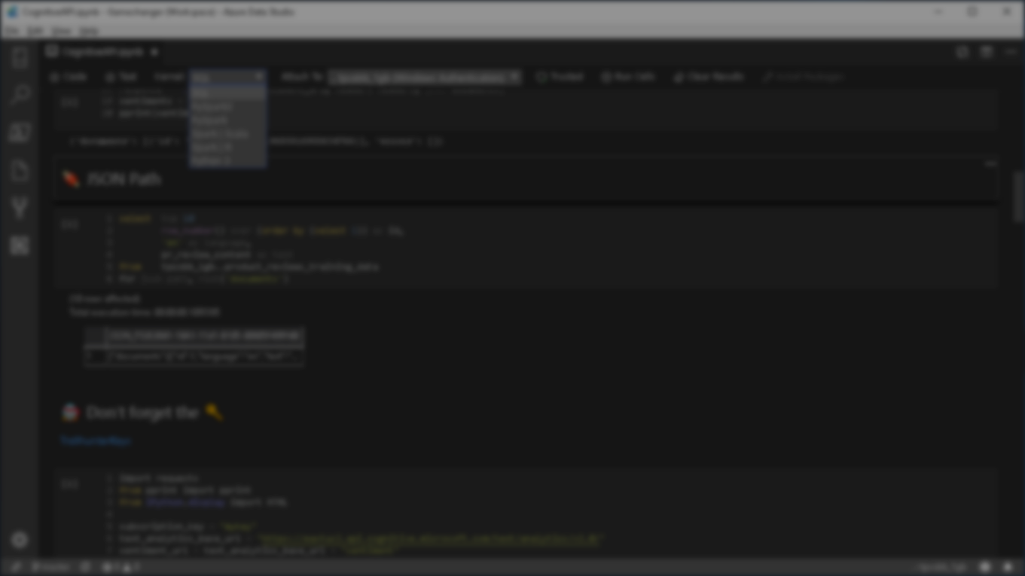







Explore everything PASS has to offer
Free online webinar events
Local user groups around the world
Free 1-day local training events
Free Online Resources
Newsletters
PASS.org
Online special interest user groups
Business analytics training
Get involved

Slide 5
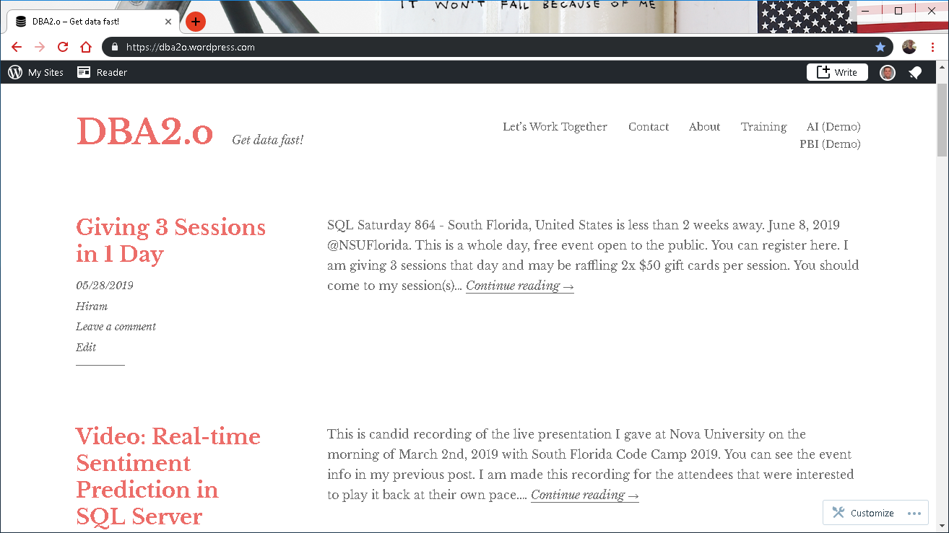

Slide 6

Session evaluations
This is the link:
bit.ly/30JwGlV
Your feedback is very important.
Submit your feedback by the end of this presentation.

Slide 7











Hiram Fleitas
Owner Fleitas Arts
Bio
Father
Principal DB Architect
Power BI since 2016
Developer since 1995
SQL Server since 1999
USCG Auxiliary Flotilla Staff Officer
@hiramfleitas
/hfleitas
hiram@fleitasarts.com
hiramfletias
fleitasarts.com

Slide 8
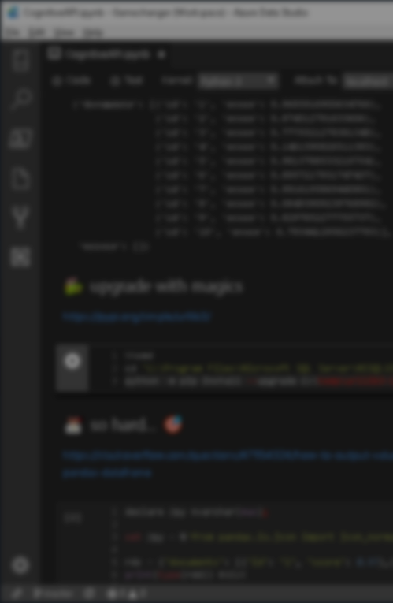

Agenda
Hack Tabular Data Stream (TDS)
Load Test Encryption
Hack Dynamic Data Masking (DDM)
Hack Row-Level Security (RLS)
DB Source Control (TFS/Git)
Resources
Raffle

Slide 9
Agenda
Hack Tabular Data Stream (TDS)
Load Test Encryption
Hack Dynamic Data Masking (DDM)
Hack Row-Level Security (RLS)
DB Source Control (TFS/Git)
Resources
Raffle

Slide 10
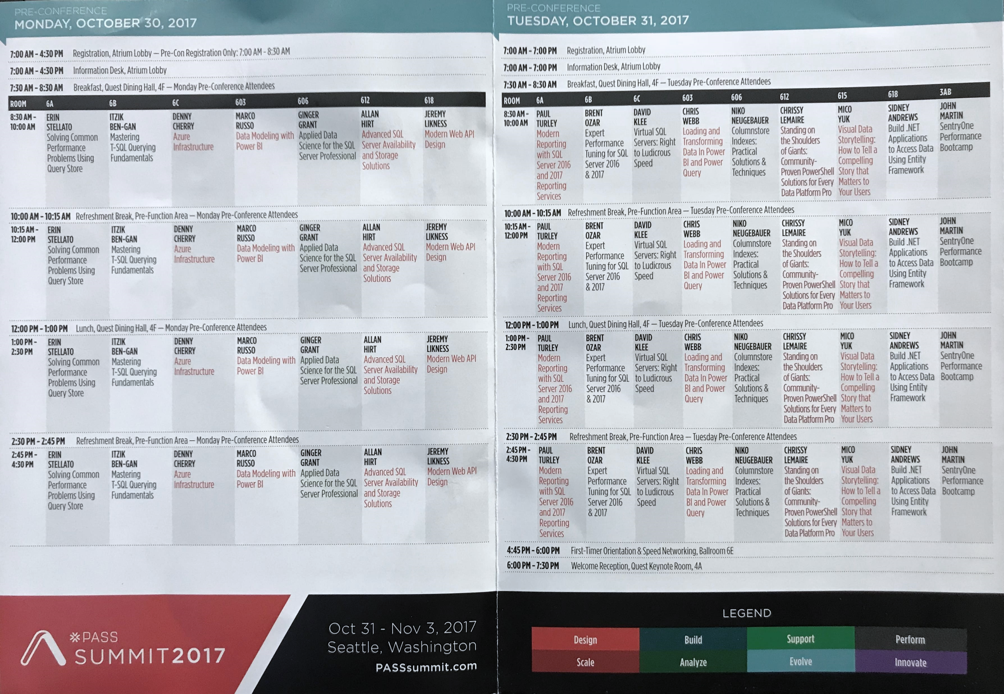
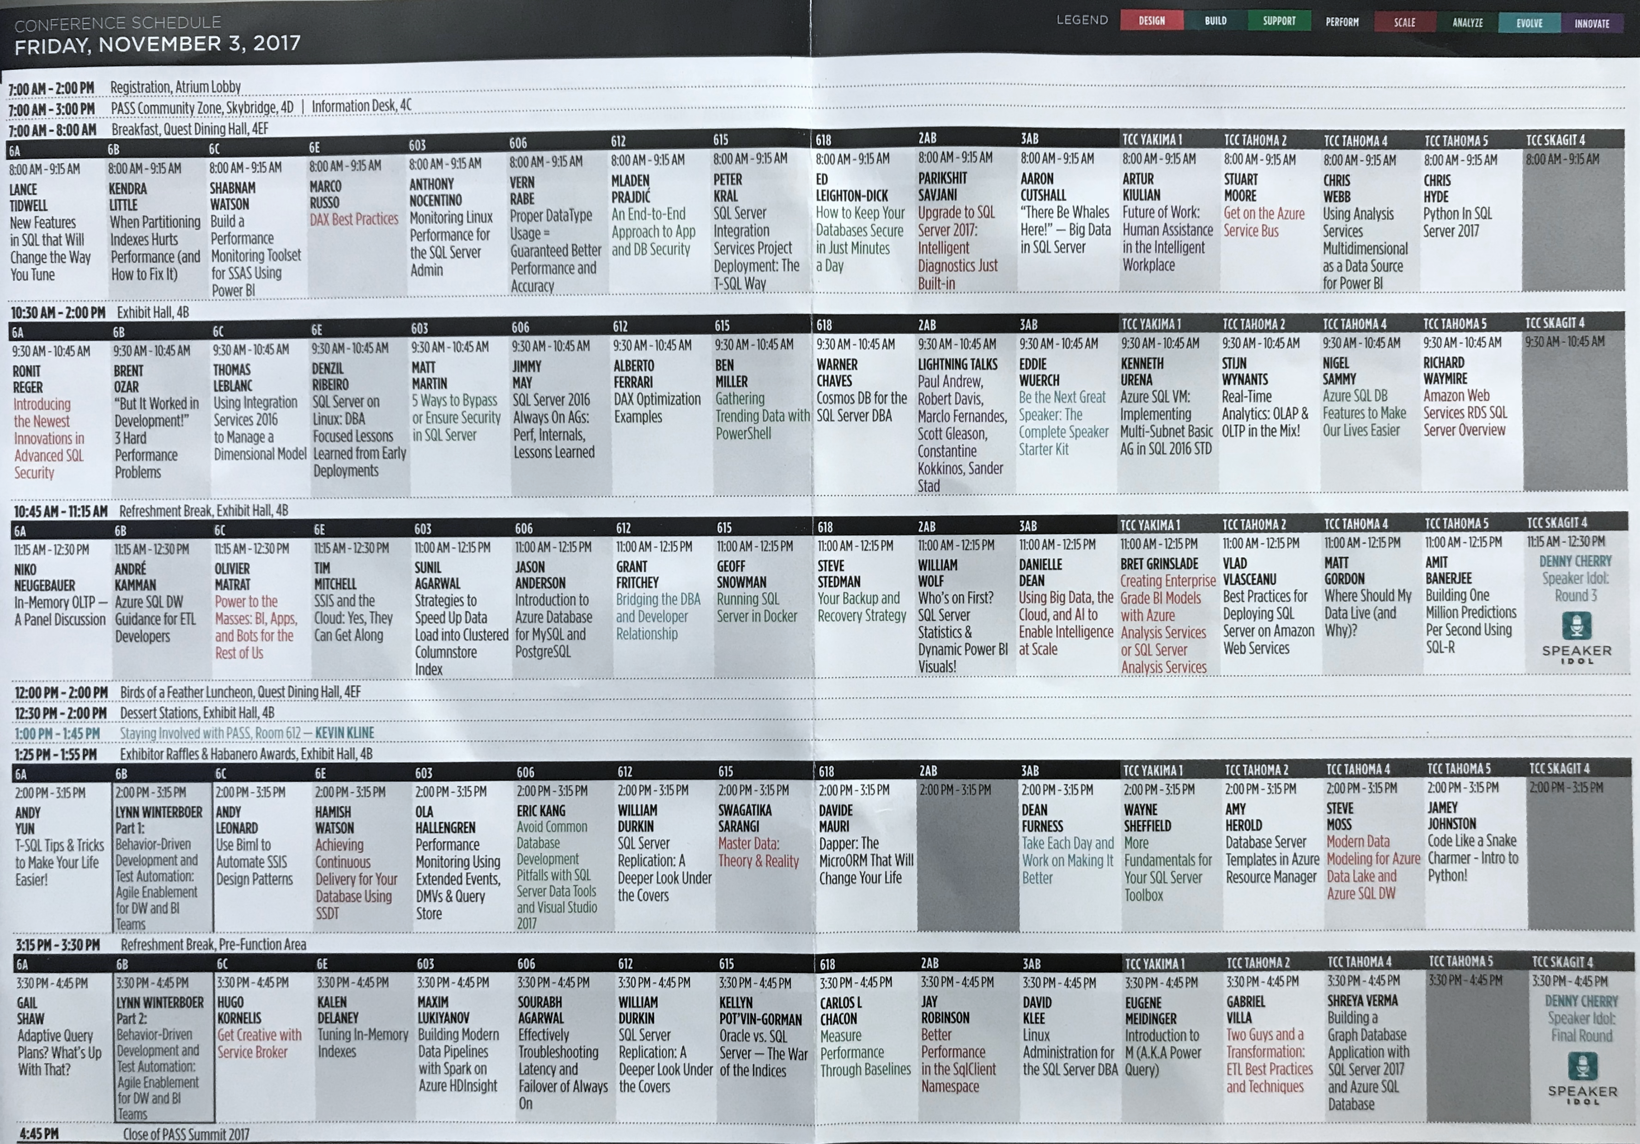
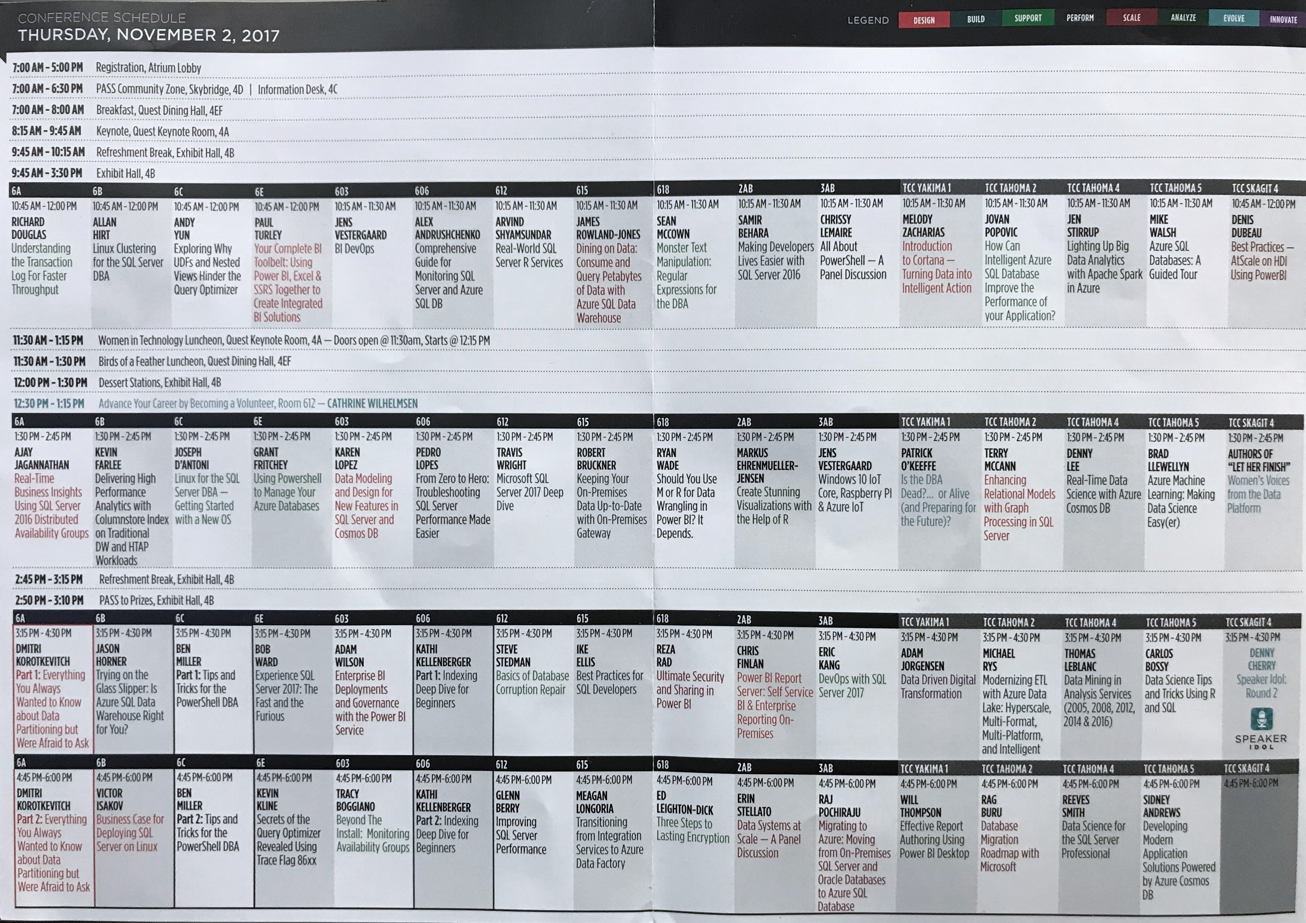
Agenda
Hack Tabular Data Stream (TDS)
Load Test Encryption
Hack Dynamic Data Masking (DDM)
Hack Row-Level Security (RLS)
DB Source Control (TFS/Git)
Resources
Raffle

Slide 11
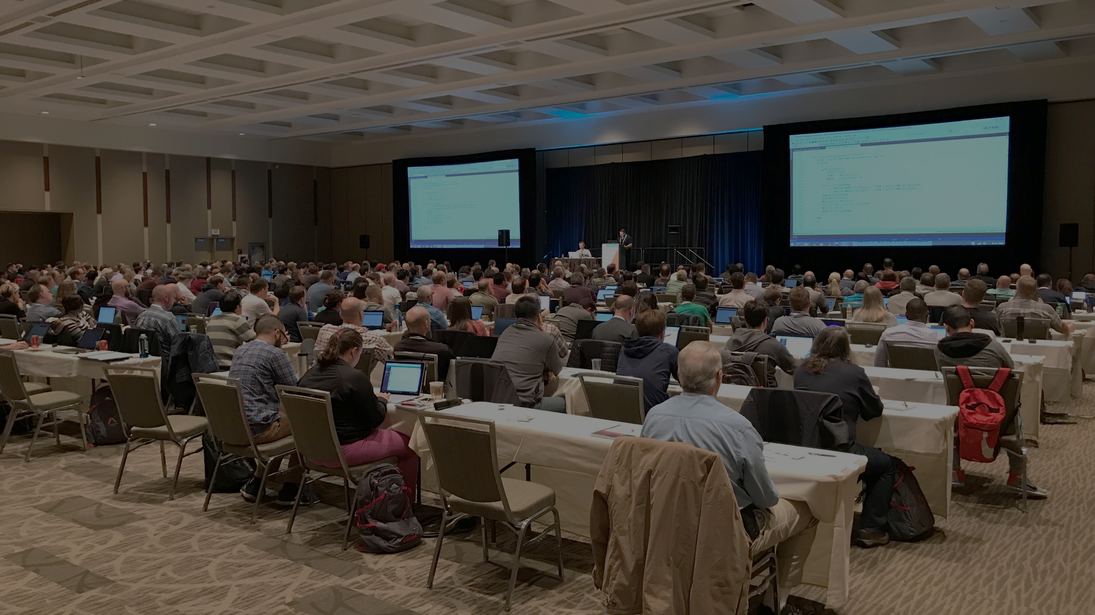
DEMO 1
TDS Encryption
Notes:
Columnstore Demo: (requirements: ssms, sql2016+)
H:\SQL\PassSummit2017\20171101-1100-TSQLTipsAndTricks\2017NeedToKnowAdaptiveJoinsOverRowstore\Demo
Performance 2017 vs 2016: (requirements: hammerdb, sql2016, sql2017)
HammerDB ASP02 (2016), SQL07 (2017) and if time allows do imoltp.
2017 Automatic Tuning: (requirements: perfmon, sqlcmd, ostress.exe, sql2017, wwi db)
C:\Deployments\demo3_sqlserverkeepsyoufast\
Copied ostress.exe into C:\Deployments\demo3_sqlserverkeepsyoufast (I had previously installed RML Utilities)
Replaced “.\sql2017” with “localhost” in files C:\Deployments\demo3_sqlserverkeepsyoufast\*.cmd (I had previously restored wwi on my local instance)
Edited setup.sql, replaced DROP procedure with DROP procedure if exists
PowerShell window 1:
PS ran .\report.cmd
PowerShell window 2:
PS perfom, performance monitor, added SQLServer:SQL Statistics:Batch Requests/sec.
PS .\repro_setup.cmd
PS .\initialize.cmd
PS .\auto_tune.cmd
PS .\regression.cmd
Docker: (requirements: docker, bios virtualization, git, stop mssql and iis local instances)
PS cd c:\deployments\sqldevops\docker_cluster\aks
Power BI:
https://community.powerbi.com/t5/Data-Stories-Gallery/US-Department-of-Transportation-Traffic-accident-analysis-1990/m-p/152287
C:\Deployments\PowerBI\USA-CAN TOR.pbix

Slide 12
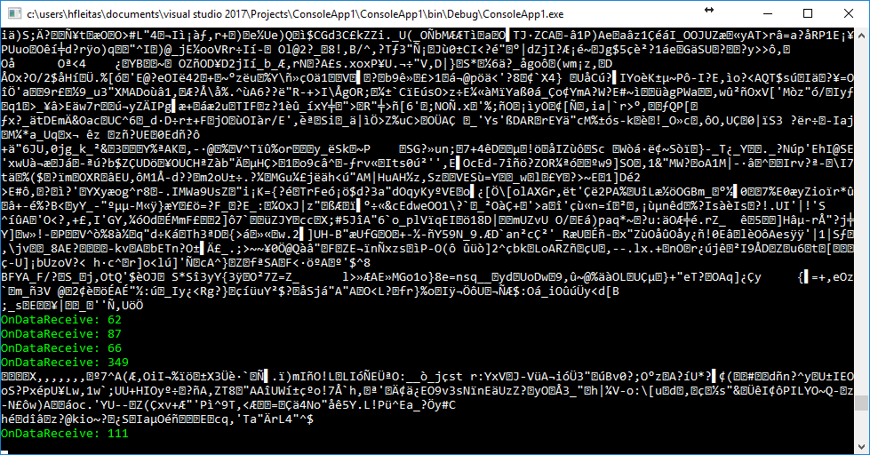

Force Encryption

Slide 13
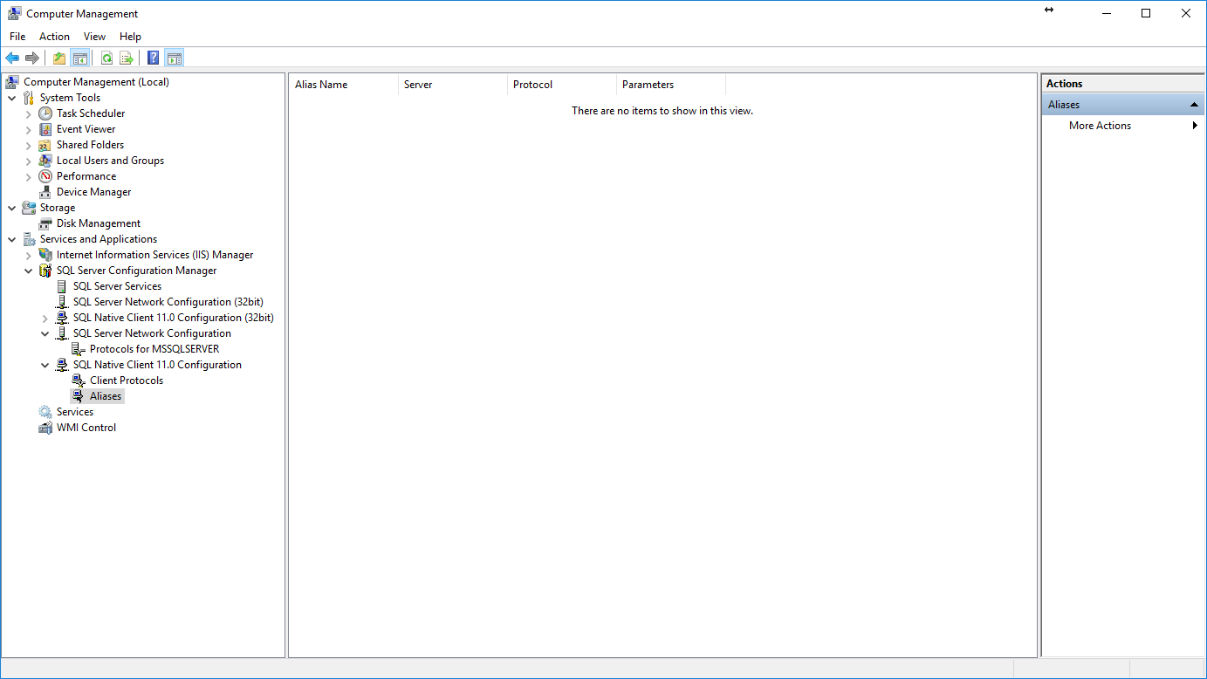
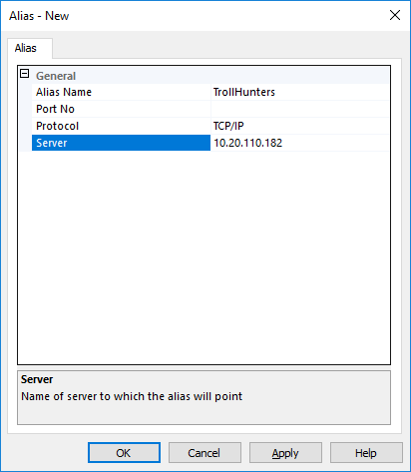
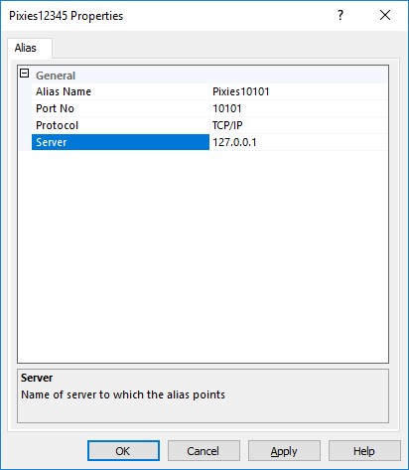
Notes:
Trollhunters MTM: (requirements: ssms, sql2008+, remote svr, vs2017 community, wireshark)
\\fldsvm_uvfile02\users$\hfleitas\SQL\PassSummit2017\20171101-1300-HackingSQLServer\TrollHunters-MITM-Demo.sql
*port number is required in alias name for the hack by TcpForwarderSlim.

Slide 14
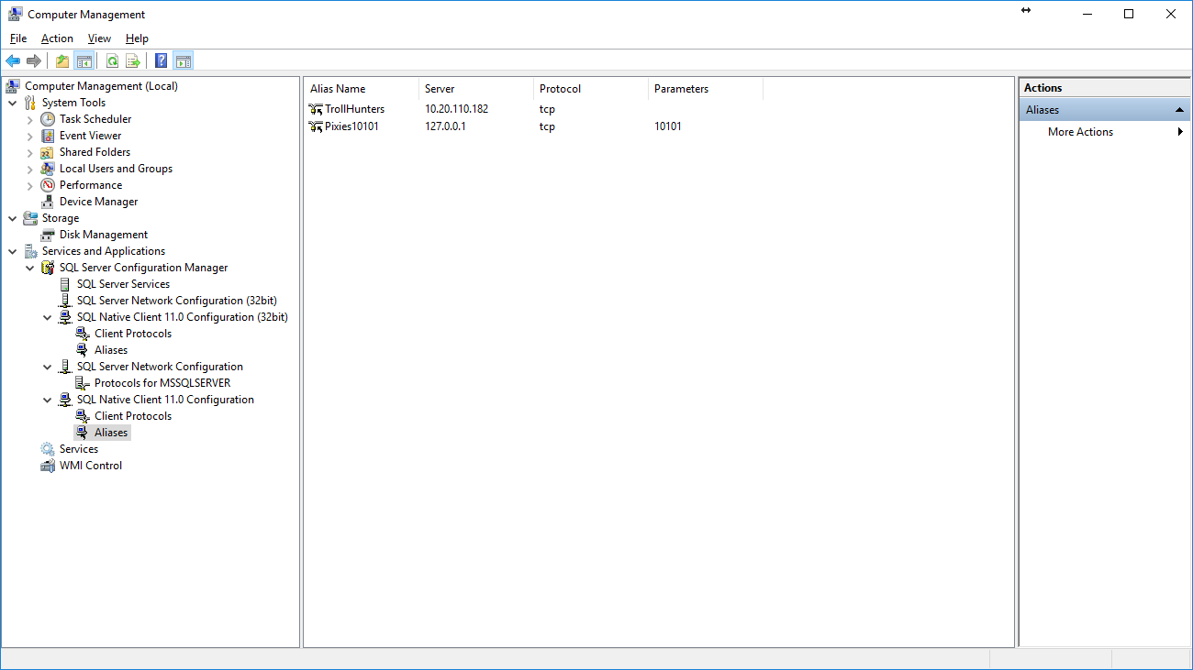
Notes:
Trollhunters MTM: (requirements: ssms, sql2008+, remote svr, vs2017 community, wireshark)
\\fldsvm_uvfile02\users$\hfleitas\SQL\PassSummit2017\20171101-1300-HackingSQLServer\TrollHunters-MITM-Demo.sql

Slide 15
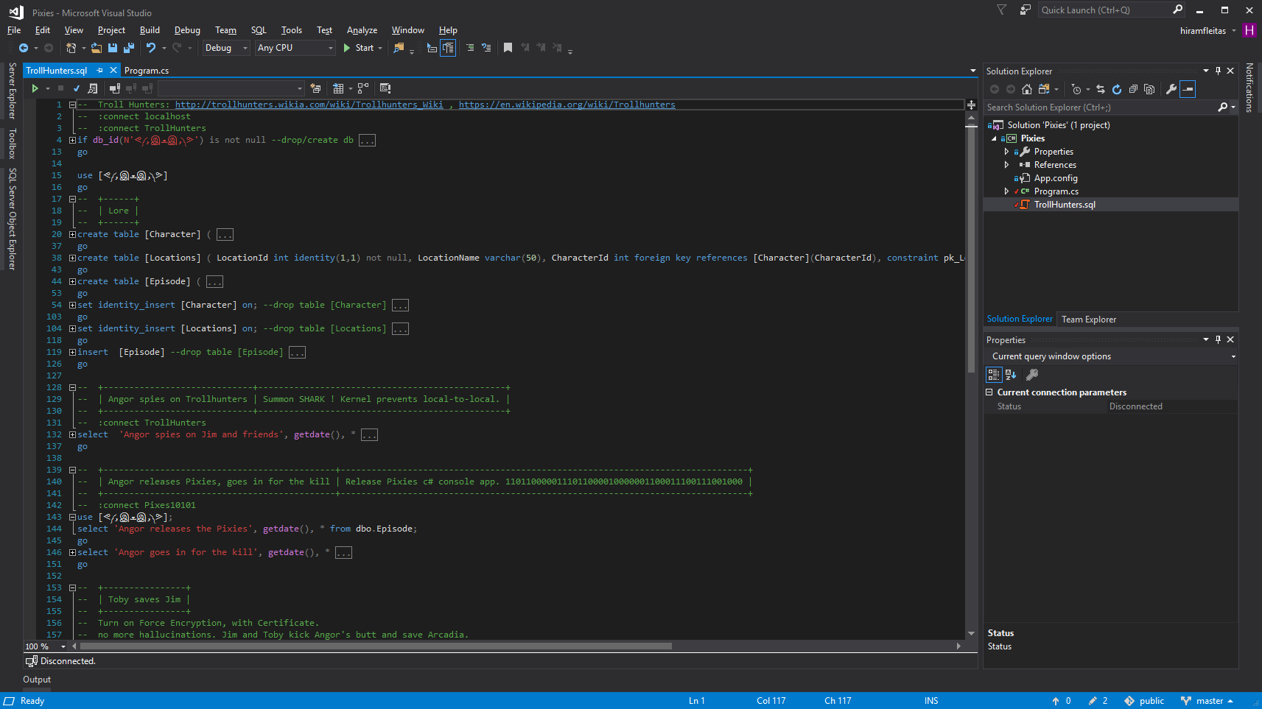
Notes:
Trollhunters MTM: (requirements: ssms, sql2008+, remote svr, vs2017 community, wireshark)
\\fldsvm_uvfile02\users$\hfleitas\SQL\PassSummit2017\20171101-1300-HackingSQLServer\TrollHunters-MITM-Demo.sql

Slide 16
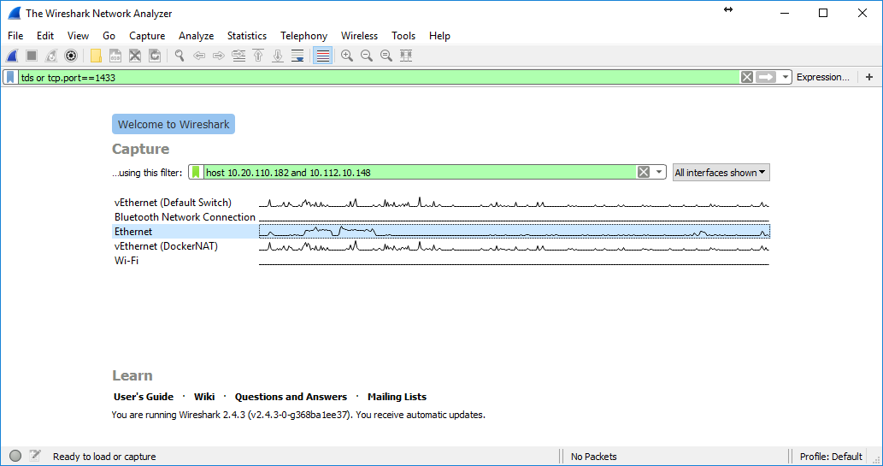
Notes:
Trollhunters MTM: (requirements: ssms, sql2008+, remote svr, vs2017 community, wireshark)
\\fldsvm_uvfile02\users$\hfleitas\SQL\PassSummit2017\20171101-1300-HackingSQLServer\TrollHunters-MITM-Demo.sql

Slide 17
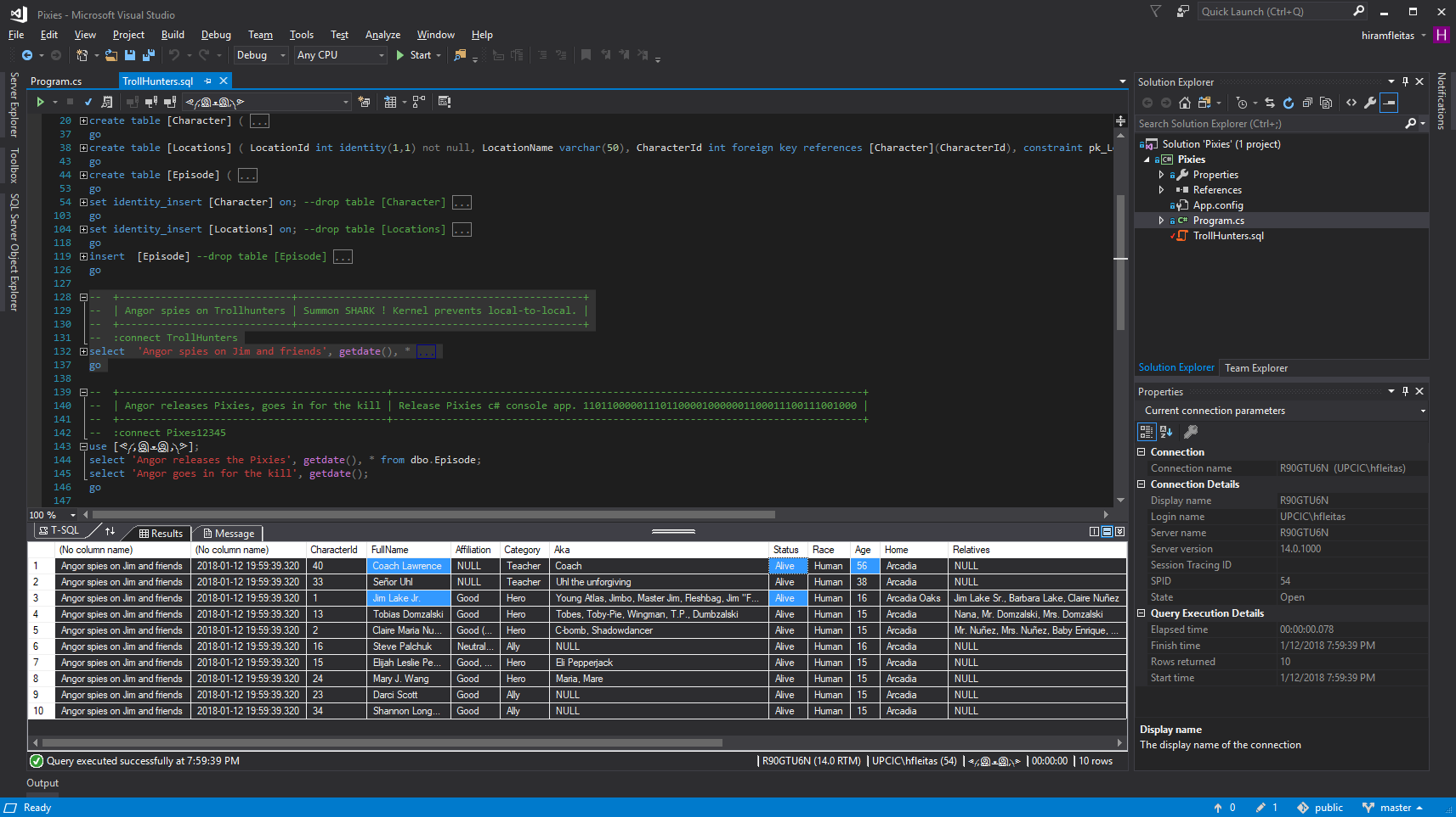
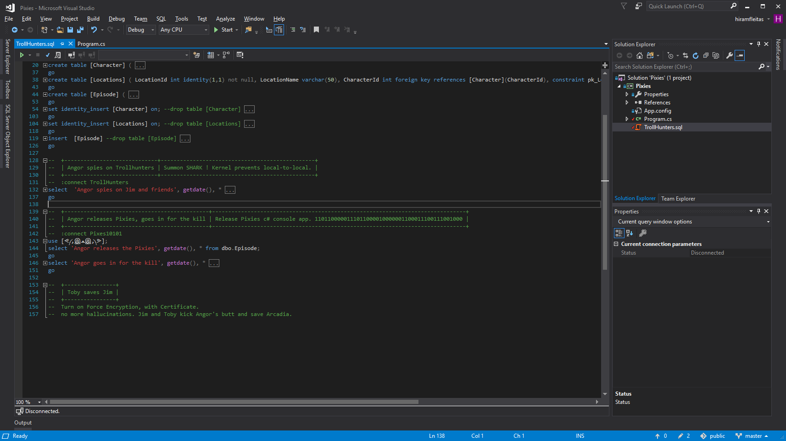
Notes:
Trollhunters MTM: (requirements: ssms, sql2008+, remote svr, vs2017 community, wireshark)
\\fldsvm_uvfile02\users$\hfleitas\SQL\PassSummit2017\20171101-1300-HackingSQLServer\TrollHunters-MITM-Demo.sql

Slide 18
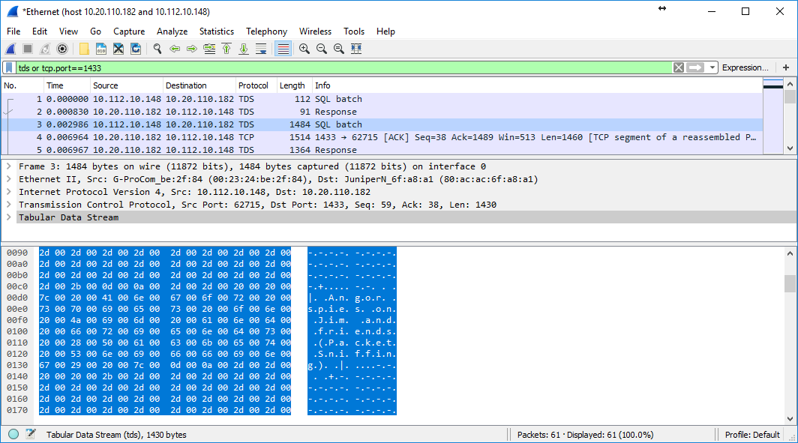
Notes:
Trollhunters MTM: (requirements: ssms, sql2008+, remote svr, vs2017 community, wireshark)
\\fldsvm_uvfile02\users$\hfleitas\SQL\PassSummit2017\20171101-1300-HackingSQLServer\TrollHunters-MITM-Demo.sql

Slide 19
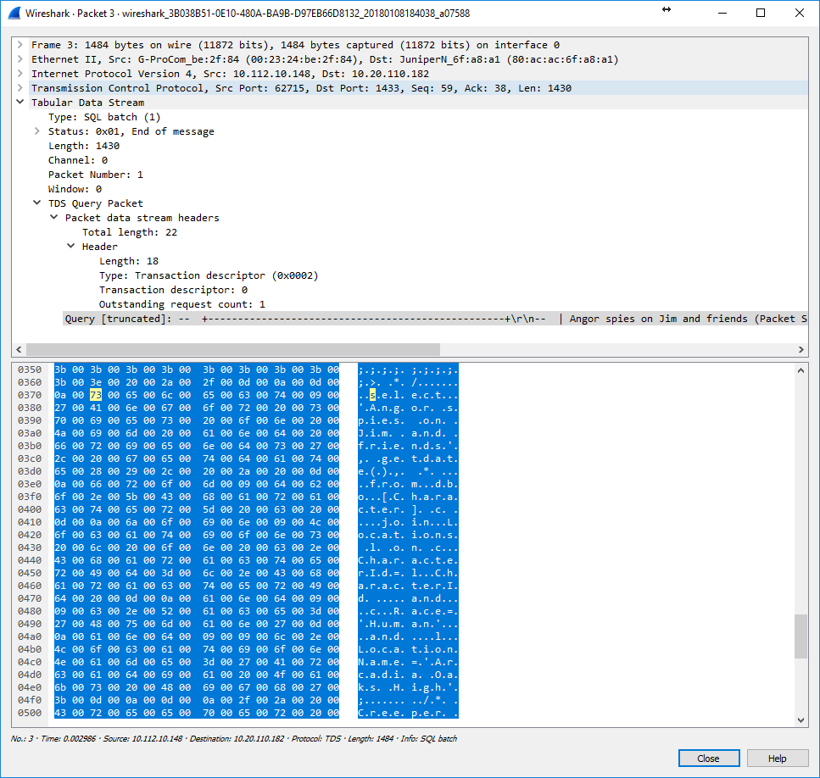
Notes:
Trollhunters MTM: (requirements: ssms, sql2008+, remote svr, vs2017 community, wireshark)
\\fldsvm_uvfile02\users$\hfleitas\SQL\PassSummit2017\20171101-1300-HackingSQLServer\TrollHunters-MITM-Demo.sql

Slide 20
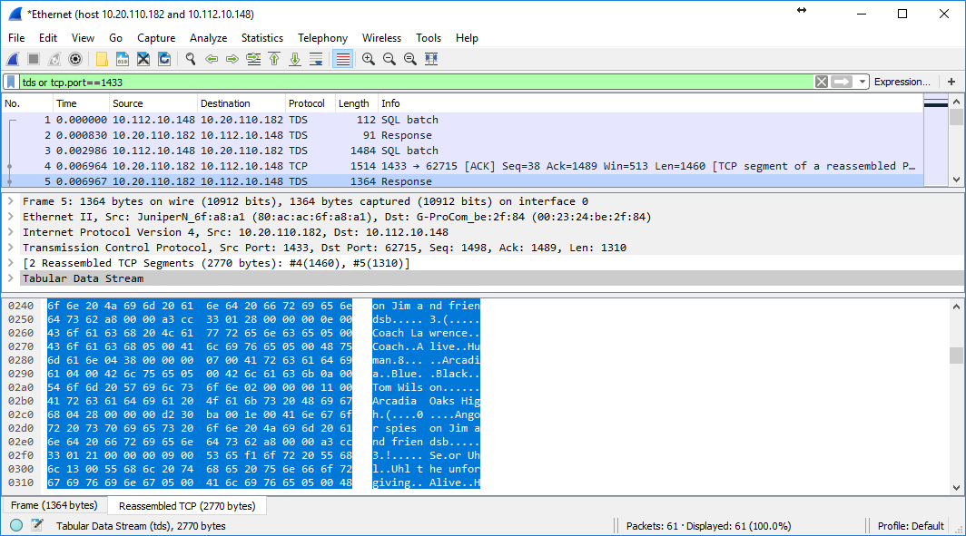
Notes:
Trollhunters MTM: (requirements: ssms, sql2008+, remote svr, vs2017 community, wireshark)
\\fldsvm_uvfile02\users$\hfleitas\SQL\PassSummit2017\20171101-1300-HackingSQLServer\TrollHunters-MITM-Demo.sql

Slide 21
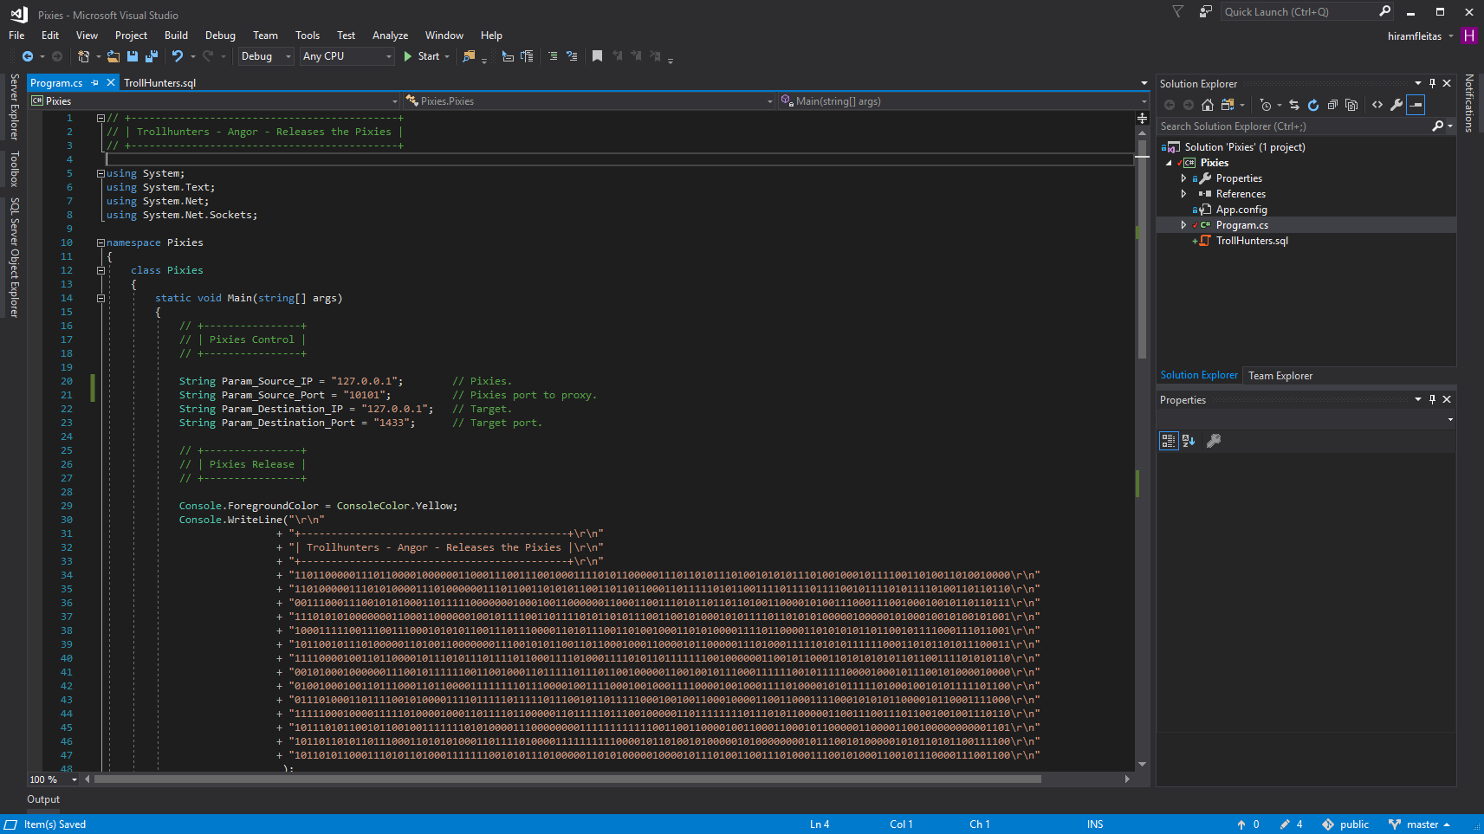
Notes:
Trollhunters MTM: (requirements: ssms, sql2008+, remote svr, vs2017 community, wireshark)
\\fldsvm_uvfile02\users$\hfleitas\SQL\PassSummit2017\20171101-1300-HackingSQLServer\TrollHunters-MITM-Demo.sql

Slide 22
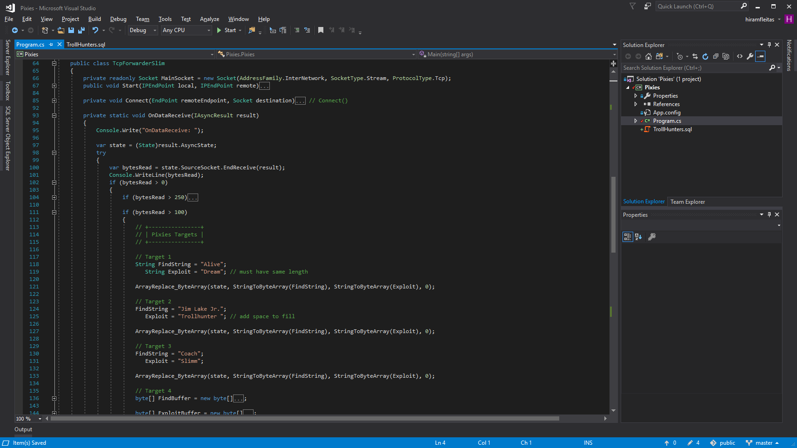
Notes:
Trollhunters MTM: (requirements: ssms, sql2008+, remote svr, vs2017 community, wireshark)
\\fldsvm_uvfile02\users$\hfleitas\SQL\PassSummit2017\20171101-1300-HackingSQLServer\TrollHunters-MITM-Demo.sql

Slide 23
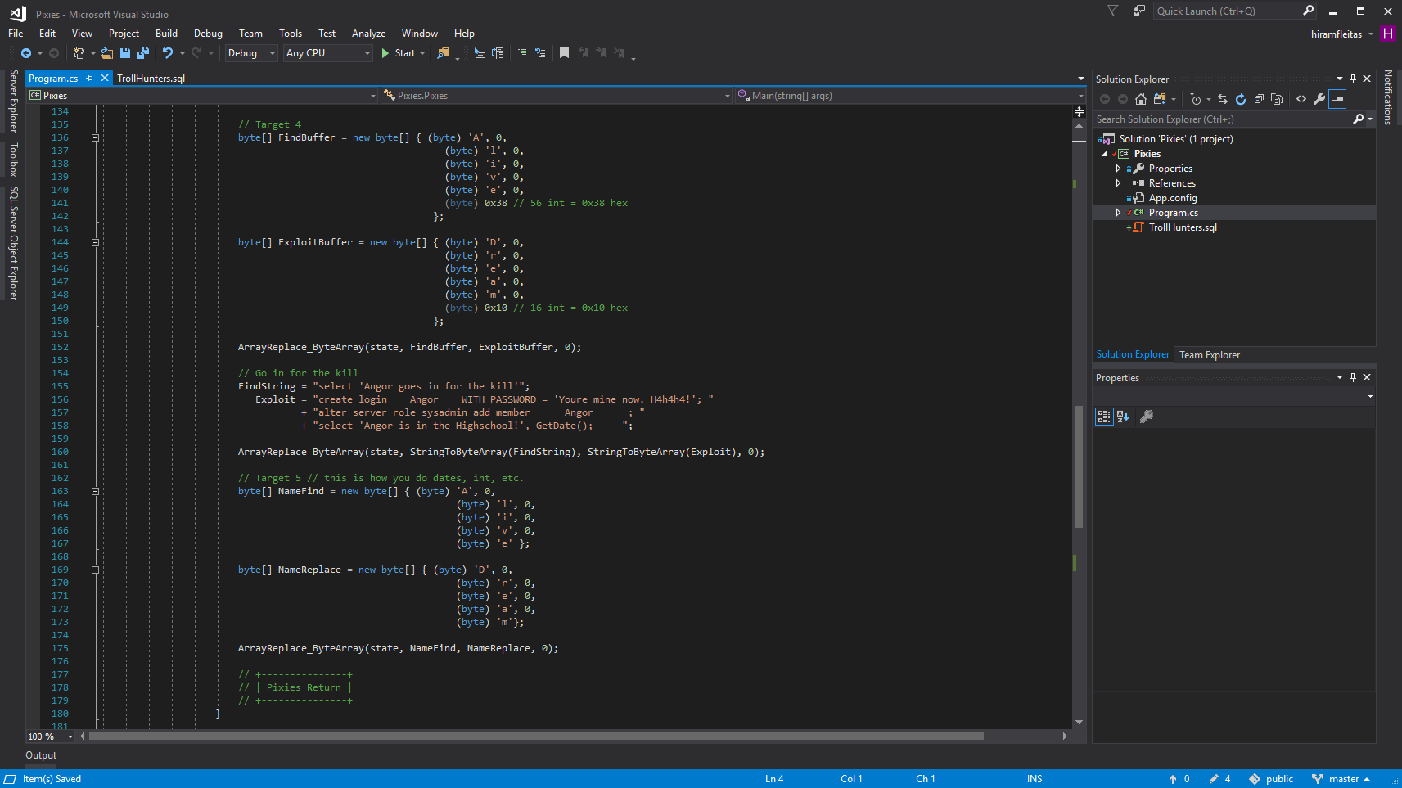
Notes:
Trollhunters MTM: (requirements: ssms, sql2008+, remote svr, vs2017 community, wireshark)
\\fldsvm_uvfile02\users$\hfleitas\SQL\PassSummit2017\20171101-1300-HackingSQLServer\TrollHunters-MITM-Demo.sql

Slide 24
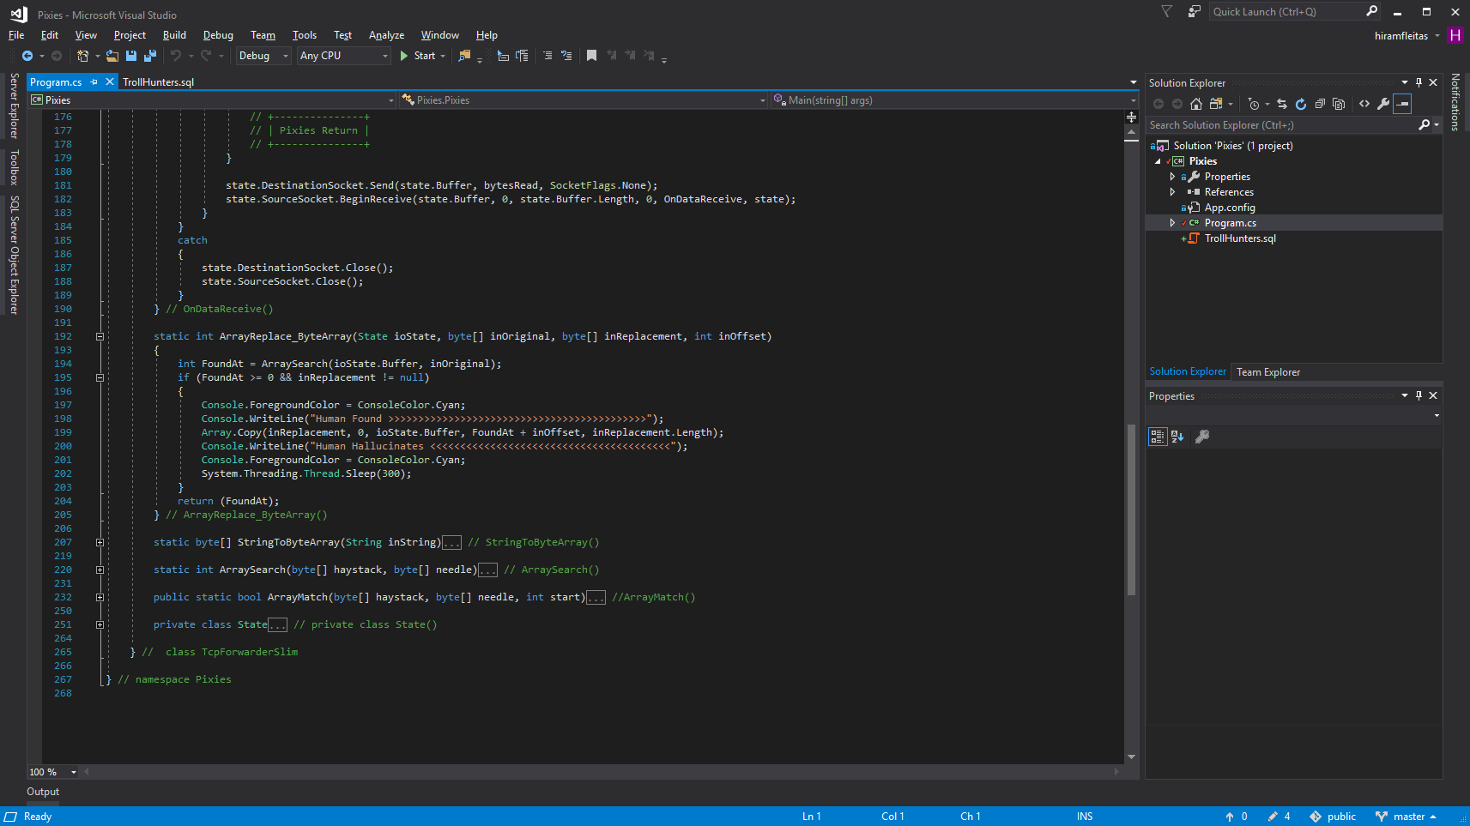
Notes:
Trollhunters MTM: (requirements: ssms, sql2008+, remote svr, vs2017 community, wireshark)
\\fldsvm_uvfile02\users$\hfleitas\SQL\PassSummit2017\20171101-1300-HackingSQLServer\TrollHunters-MITM-Demo.sql

Slide 25
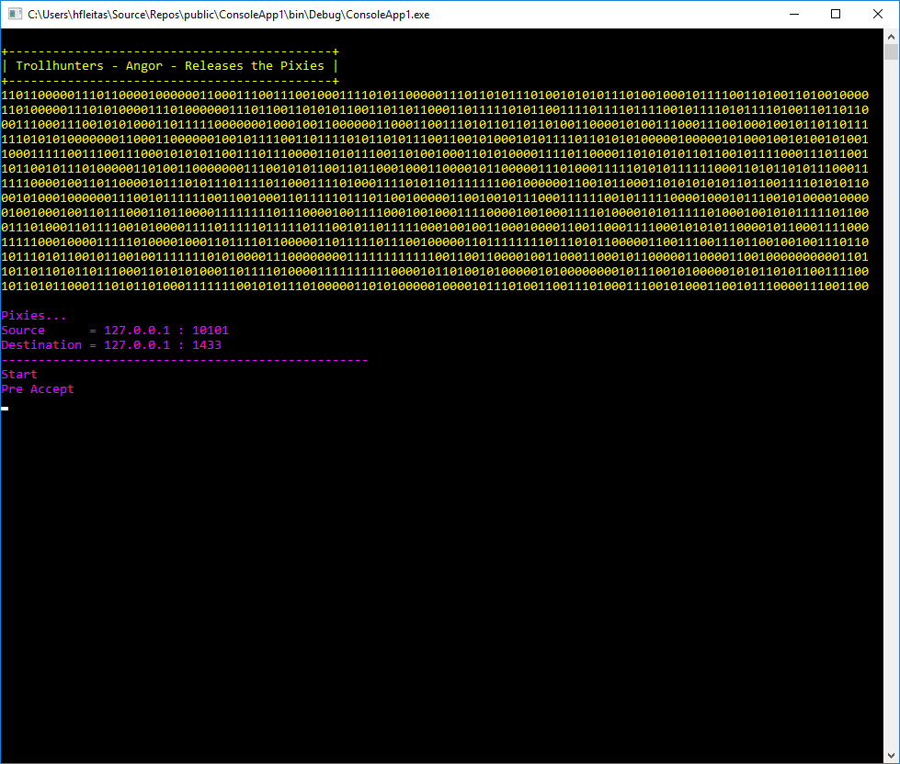
Notes:
Trollhunters MTM: (requirements: ssms, sql2008+, remote svr, vs2017 community, wireshark)
\\fldsvm_uvfile02\users$\hfleitas\SQL\PassSummit2017\20171101-1300-HackingSQLServer\TrollHunters-MITM-Demo.sql

Slide 26
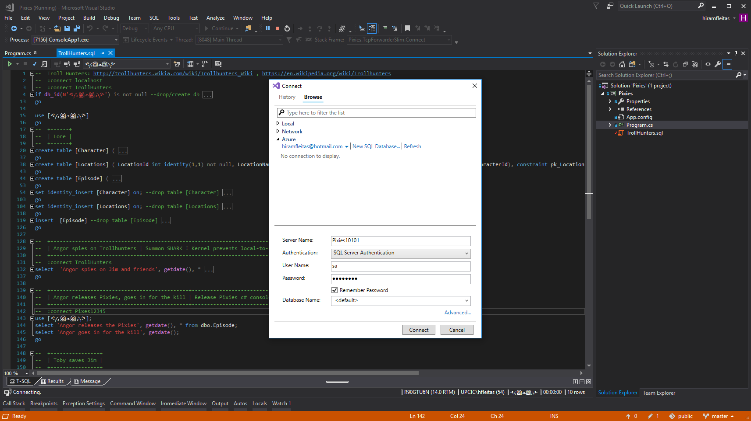
Notes:
Trollhunters MTM: (requirements: ssms, sql2008+, remote svr, vs2017 community, wireshark)
\\fldsvm_uvfile02\users$\hfleitas\SQL\PassSummit2017\20171101-1300-HackingSQLServer\TrollHunters-MITM-Demo.sql
TURN OFF INTELLISENSE before connecting.

Slide 27
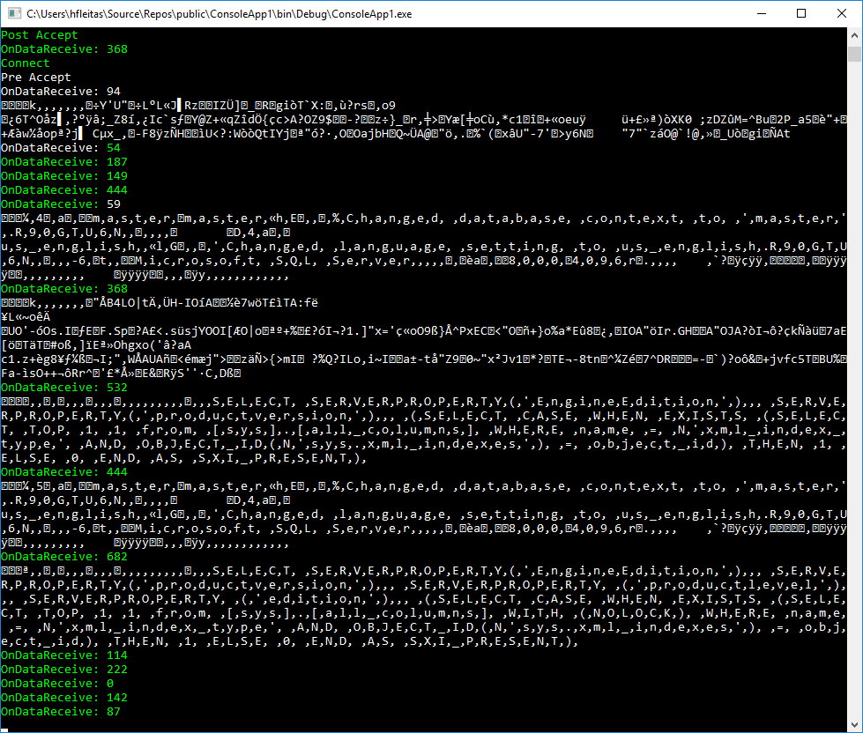
Notes:
Trollhunters MTM: (requirements: ssms, sql2008+, remote svr, vs2017 community, wireshark)
\\fldsvm_uvfile02\users$\hfleitas\SQL\PassSummit2017\20171101-1300-HackingSQLServer\TrollHunters-MITM-Demo.sql

Slide 28
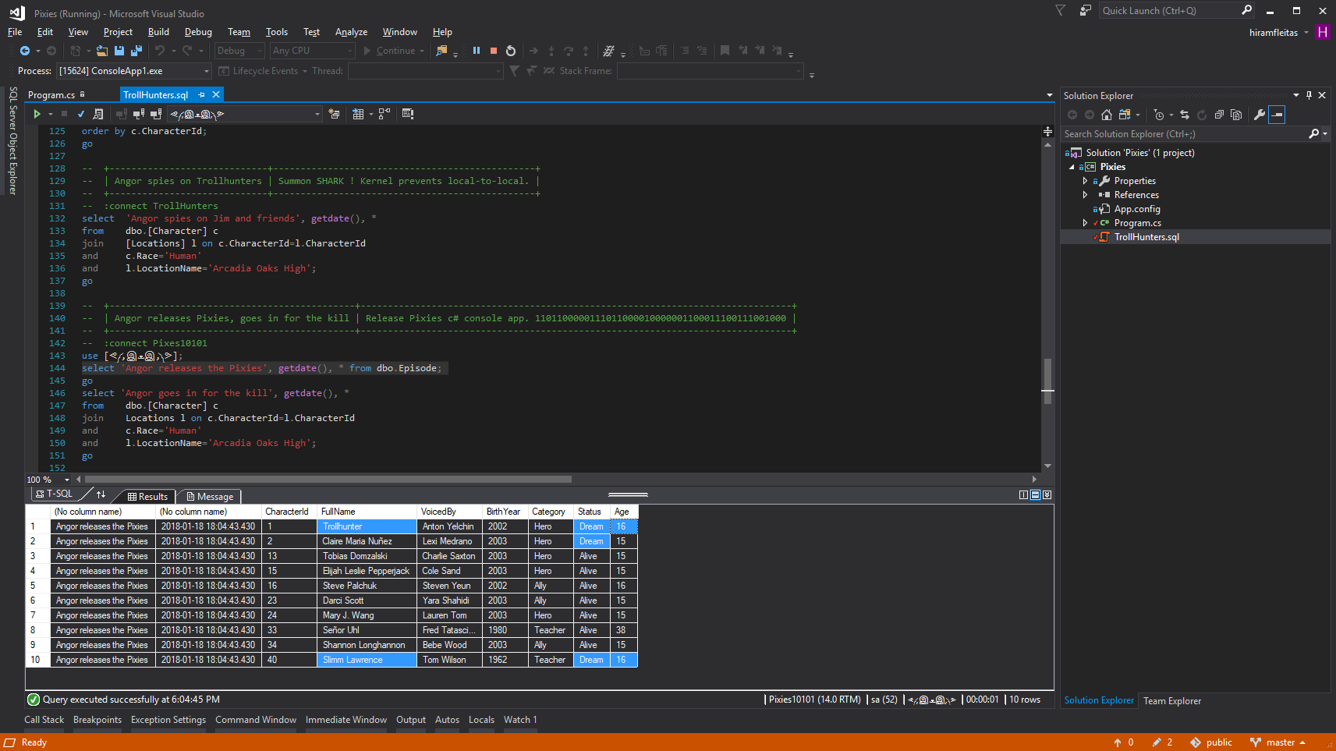
Notes:
Trollhunters MTM: (requirements: ssms, sql2008+, remote svr, vs2017 community, wireshark)
\\fldsvm_uvfile02\users$\hfleitas\SQL\PassSummit2017\20171101-1300-HackingSQLServer\TrollHunters-MITM-Demo.sql

Slide 29
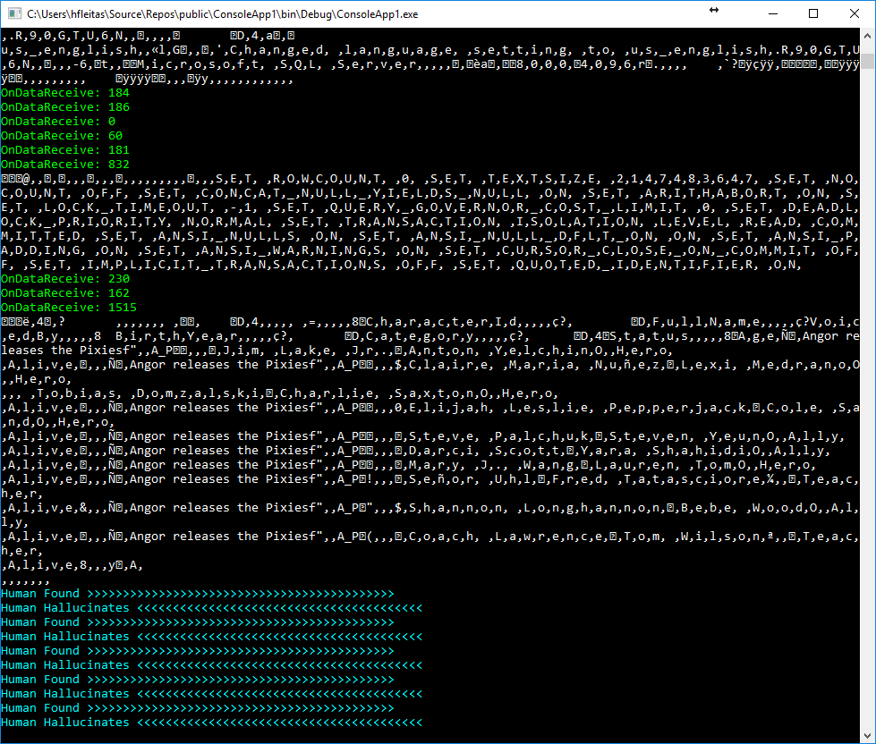
Notes:
Trollhunters MTM: (requirements: ssms, sql2008+, remote svr, vs2017 community, wireshark)
\\fldsvm_uvfile02\users$\hfleitas\SQL\PassSummit2017\20171101-1300-HackingSQLServer\TrollHunters-MITM-Demo.sql

Slide 30
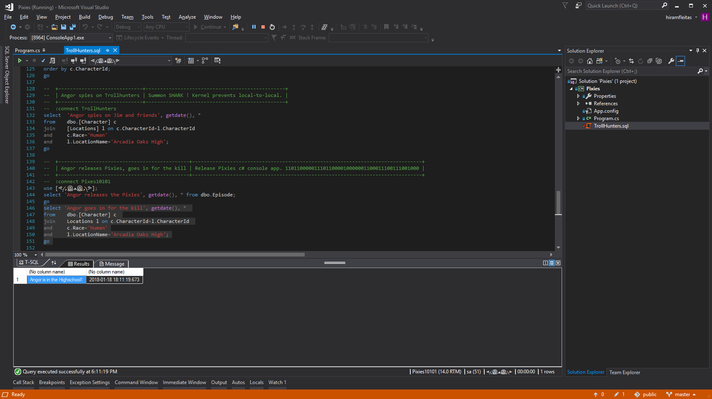
Notes:
Trollhunters MTM: (requirements: ssms, sql2008+, remote svr, vs2017 community, wireshark)
\\fldsvm_uvfile02\users$\hfleitas\SQL\PassSummit2017\20171101-1300-HackingSQLServer\TrollHunters-MITM-Demo.sql

Slide 31
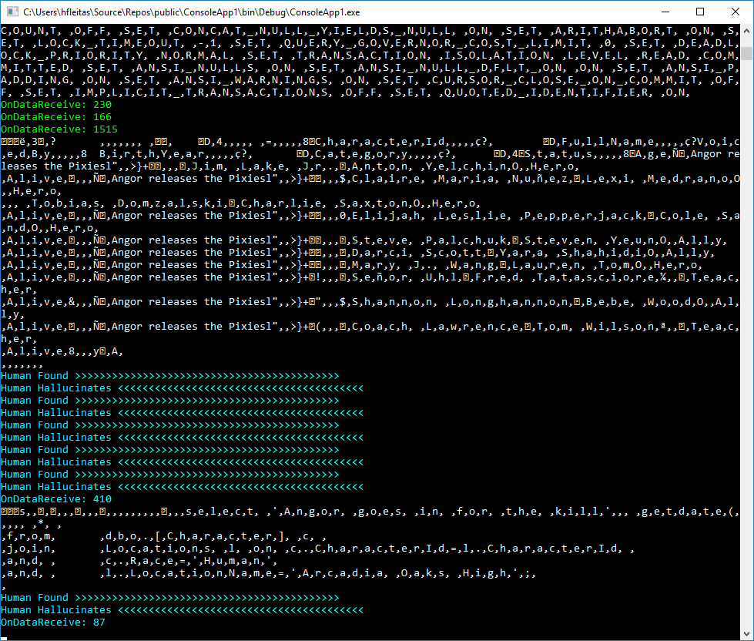
Notes:
Trollhunters MTM: (requirements: ssms, sql2008+, remote svr, vs2017 community, wireshark)
\\fldsvm_uvfile02\users$\hfleitas\SQL\PassSummit2017\20171101-1300-HackingSQLServer\TrollHunters-MITM-Demo.sql

Slide 32
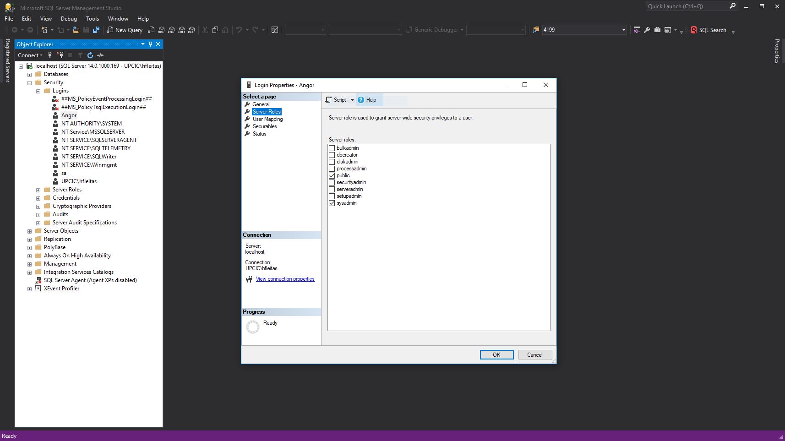
Notes:
Trollhunters MTM: (requirements: ssms, sql2008+, remote svr, vs2017 community, wireshark)
\\fldsvm_uvfile02\users$\hfleitas\SQL\PassSummit2017\20171101-1300-HackingSQLServer\TrollHunters-MITM-Demo.sql

Slide 33
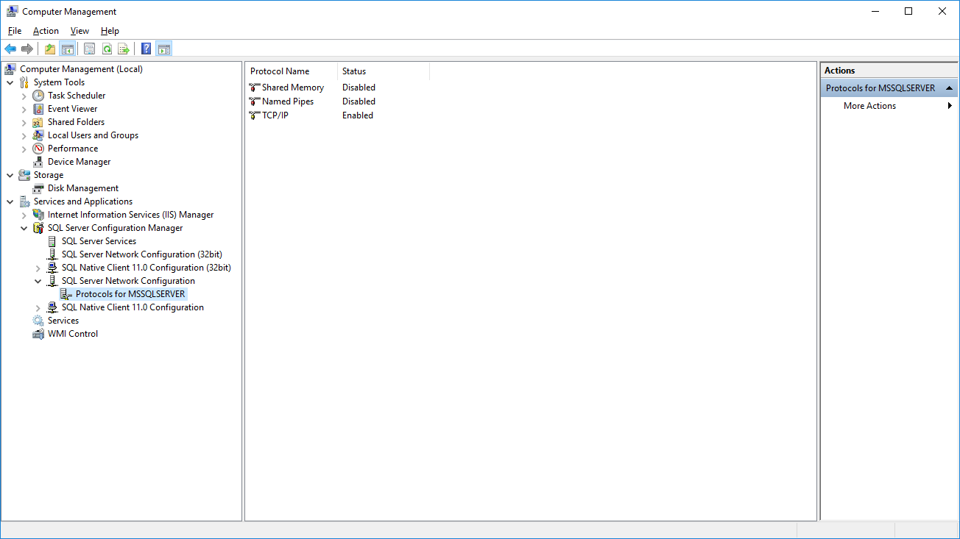
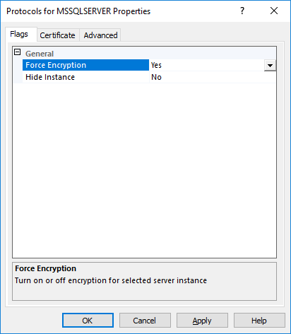
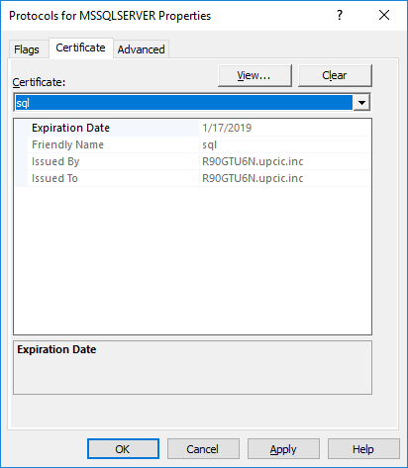
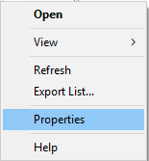
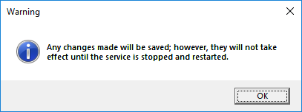
Notes:
Trollhunters MTM: (requirements: ssms, sql2008+, remote svr, vs2017 community, wireshark)
\\fldsvm_uvfile02\users$\hfleitas\SQL\PassSummit2017\20171101-1300-HackingSQLServer\TrollHunters-MITM-Demo.sql
Ref: https://docs.microsoft.com/en-us/sql/database-engine/configure-windows/enable-encrypted-connections-to-the-database-engine
Note:
To use encryption with a failover cluster, you must install the server certificate with the fully qualified DNS name of the virtual server on all nodes in the failover cluster. For example, if you have a two-node cluster, with nodes named test1.<your company>.com and test2.<your company>.com, and you have a virtual server named virtsql, you need to install a certificate for virtsql.<your company>.com on both nodes. You can set the value of the ForceEncryptionoption to Yes.

Slide 34
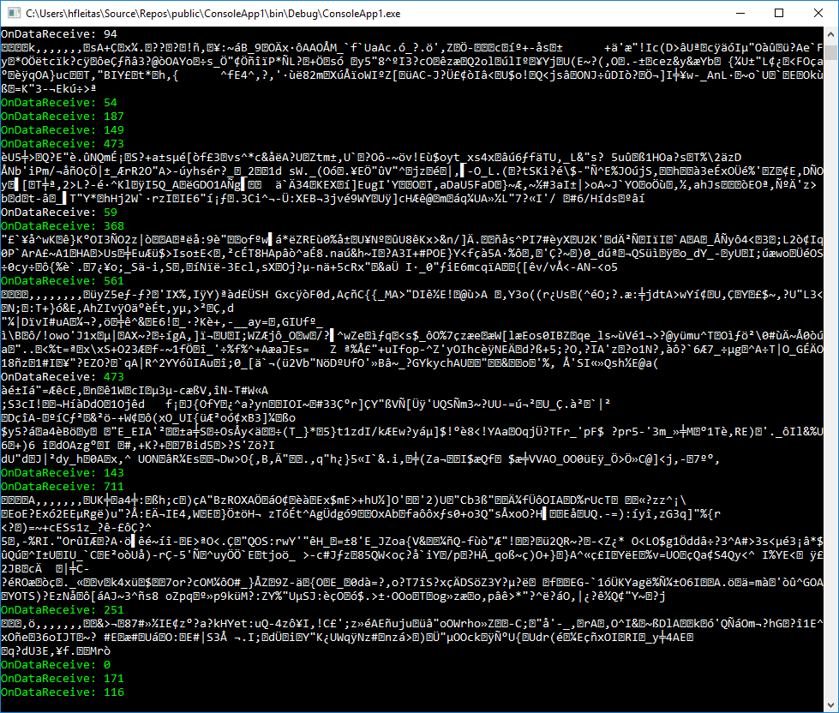
Notes:
Trollhunters MTM: (requirements: ssms, sql2008+, remote svr, vs2017 community, wireshark)
\\fldsvm_uvfile02\users$\hfleitas\SQL\PassSummit2017\20171101-1300-HackingSQLServer\TrollHunters-MITM-Demo.sql

Slide 35
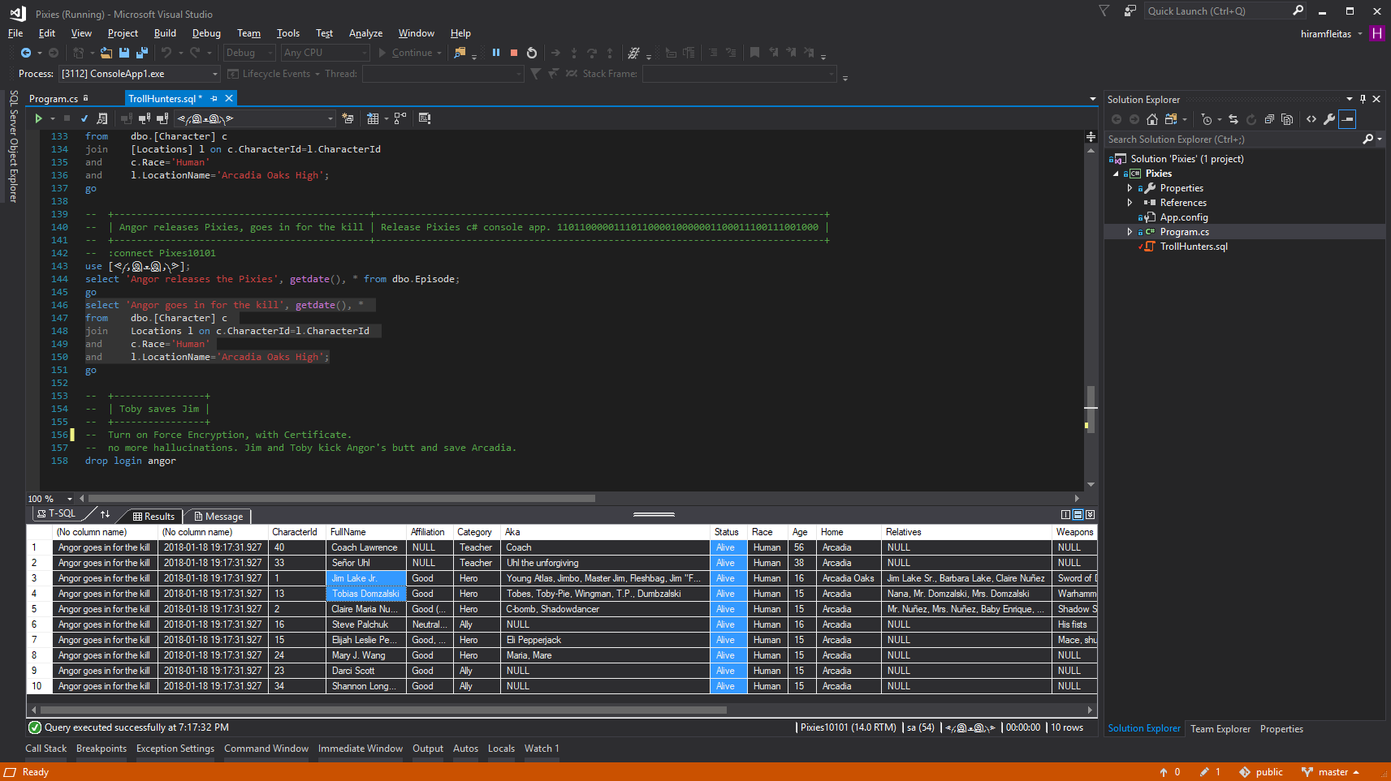
Notes:
Trollhunters MTM: (requirements: ssms, sql2008+, remote svr, vs2017 community, wireshark)
\\fldsvm_uvfile02\users$\hfleitas\SQL\PassSummit2017\20171101-1300-HackingSQLServer\TrollHunters-MITM-Demo.sql

Slide 36
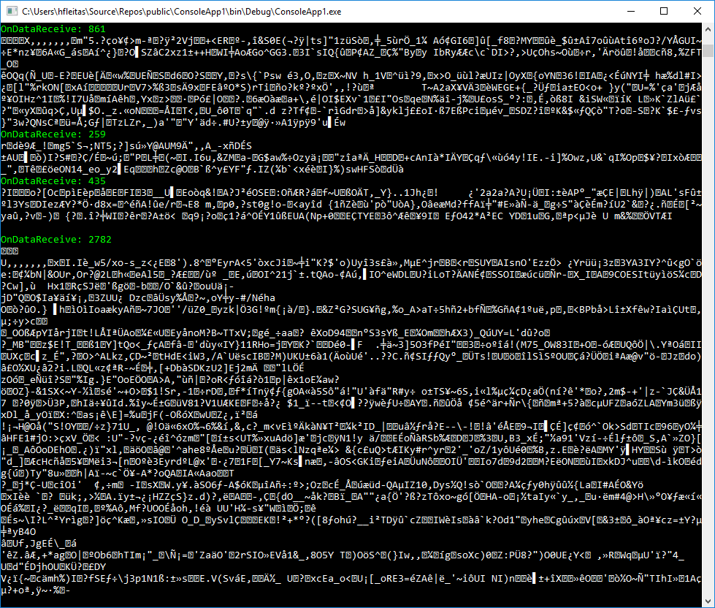
Notes:
Trollhunters MTM: (requirements: ssms, sql2008+, remote svr, vs2017 community, wireshark)
\\fldsvm_uvfile02\users$\hfleitas\SQL\PassSummit2017\20171101-1300-HackingSQLServer\TrollHunters-MITM-Demo.sql

Slide 37
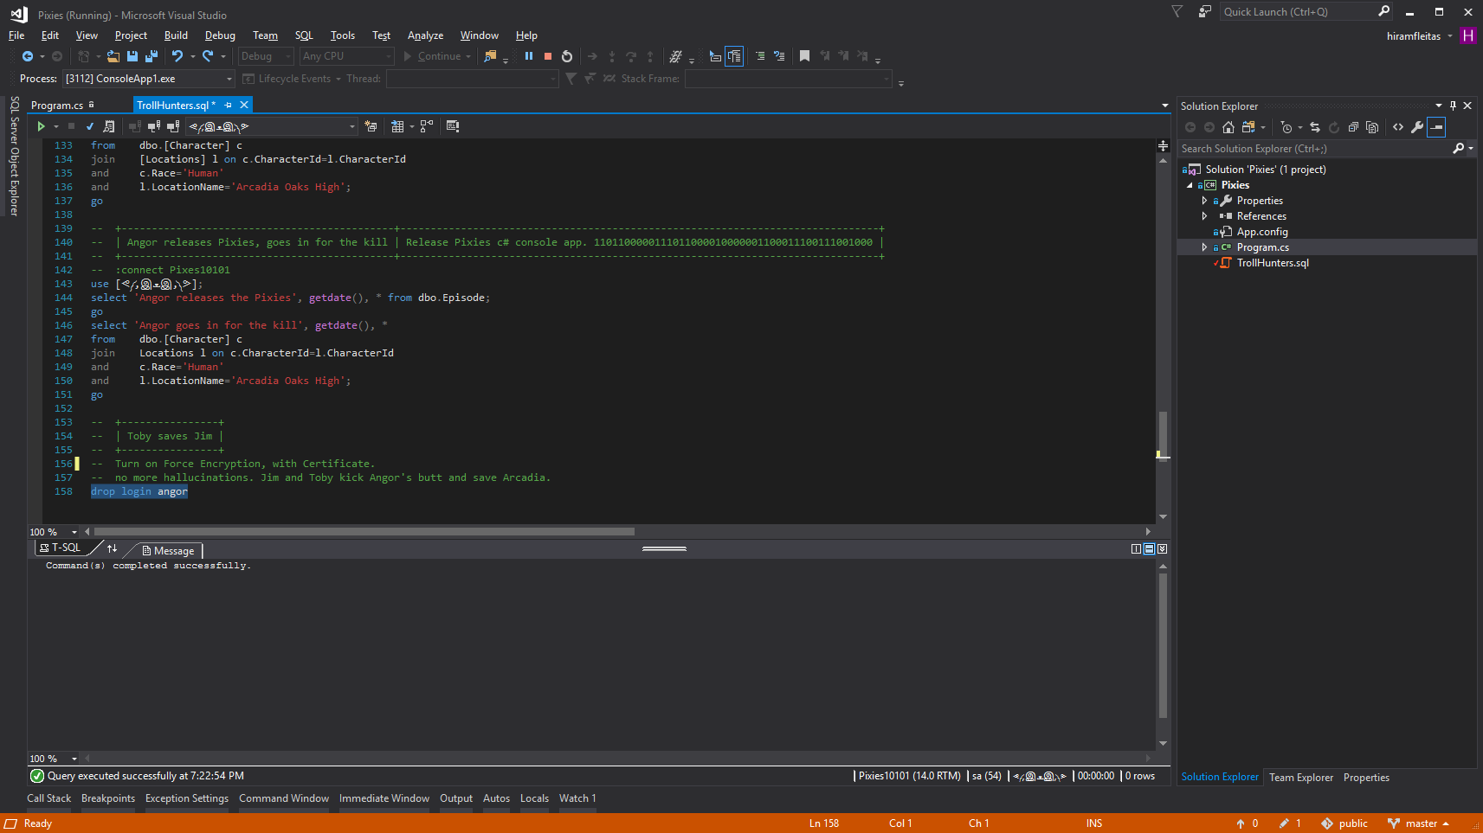
Notes:
Trollhunters MTM: (requirements: ssms, sql2008+, remote svr, vs2017 community, wireshark)
\\fldsvm_uvfile02\users$\hfleitas\SQL\PassSummit2017\20171101-1300-HackingSQLServer\TrollHunters-MITM-Demo.sql

Slide 38
DEMO 2
Load Test
Notes:
Columnstore Demo: (requirements: ssms, sql2016+)
H:\SQL\PassSummit2017\20171101-1100-TSQLTipsAndTricks\2017NeedToKnowAdaptiveJoinsOverRowstore\Demo
Performance 2017 vs 2016: (requirements: hammerdb, sql2016, sql2017)
HammerDB ASP02 (2016), SQL07 (2017) and if time allows do imoltp.
2017 Automatic Tuning: (requirements: perfmon, sqlcmd, ostress.exe, sql2017, wwi db)
C:\Deployments\demo3_sqlserverkeepsyoufast\
Copied ostress.exe into C:\Deployments\demo3_sqlserverkeepsyoufast (I had previously installed RML Utilities)
Replaced “.\sql2017” with “localhost” in files C:\Deployments\demo3_sqlserverkeepsyoufast\*.cmd (I had previously restored wwi on my local instance)
Edited setup.sql, replaced DROP procedure with DROP procedure if exists
PowerShell window 1:
PS ran .\report.cmd
PowerShell window 2:
PS perfom, performance monitor, added SQLServer:SQL Statistics:Batch Requests/sec.
PS .\repro_setup.cmd
PS .\initialize.cmd
PS .\auto_tune.cmd
PS .\regression.cmd
Docker: (requirements: docker, bios virtualization, git, stop mssql and iis local instances)
PS cd c:\deployments\sqldevops\docker_cluster\aks
Power BI:
https://community.powerbi.com/t5/Data-Stories-Gallery/US-Department-of-Transportation-Traffic-accident-analysis-1990/m-p/152287
C:\Deployments\PowerBI\USA-CAN TOR.pbix

Slide 39
Load Test Comparison

Slide 40
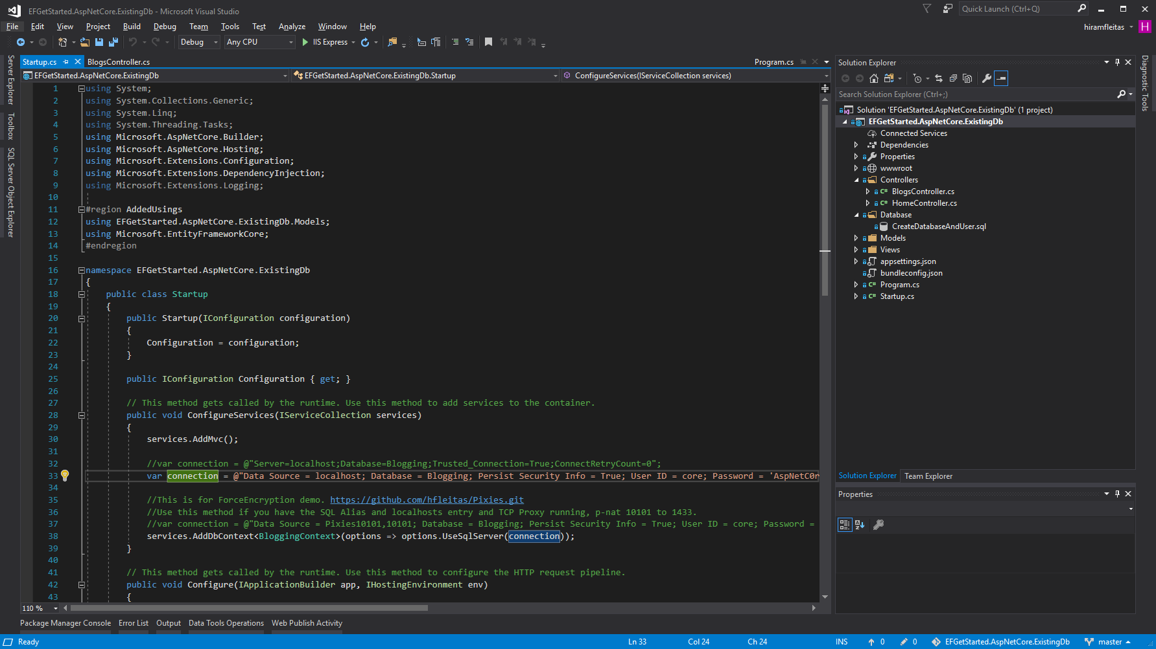
Notes:
Trollhunters MTM: (requirements: ssms, sql2008+, remote svr, vs2017 community, wireshark)
\\fldsvm_uvfile02\users$\hfleitas\SQL\PassSummit2017\20171101-1300-HackingSQLServer\TrollHunters-MITM-Demo.sql
https://github.com/hfleitas/EFGetStarted.AspNetCore.ExistingDb

Slide 41
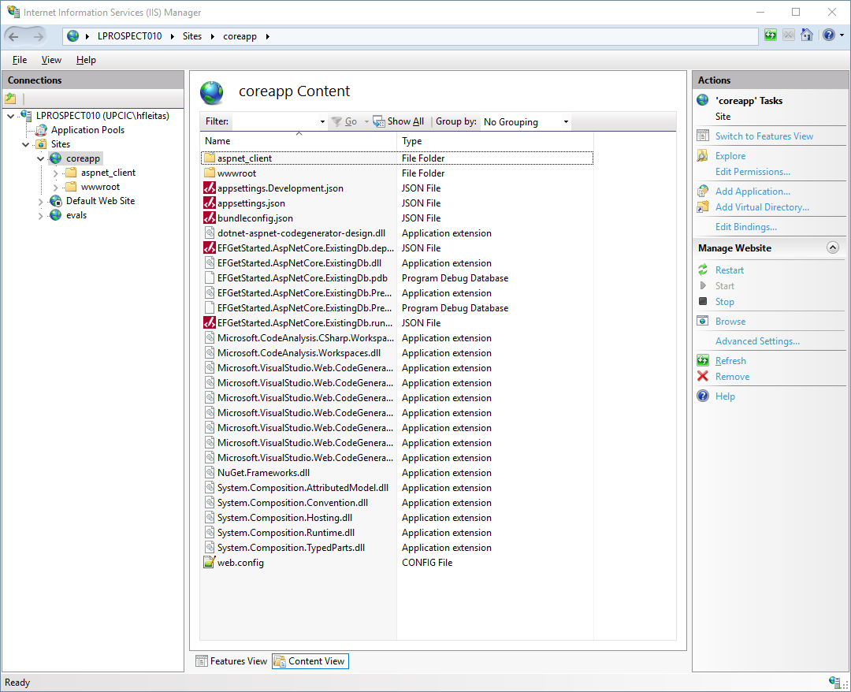
Notes:
Trollhunters MTM: (requirements: ssms, sql2008+, remote svr, vs2017 community, wireshark)
\\fldsvm_uvfile02\users$\hfleitas\SQL\PassSummit2017\20171101-1300-HackingSQLServer\TrollHunters-MITM-Demo.sql

Slide 42
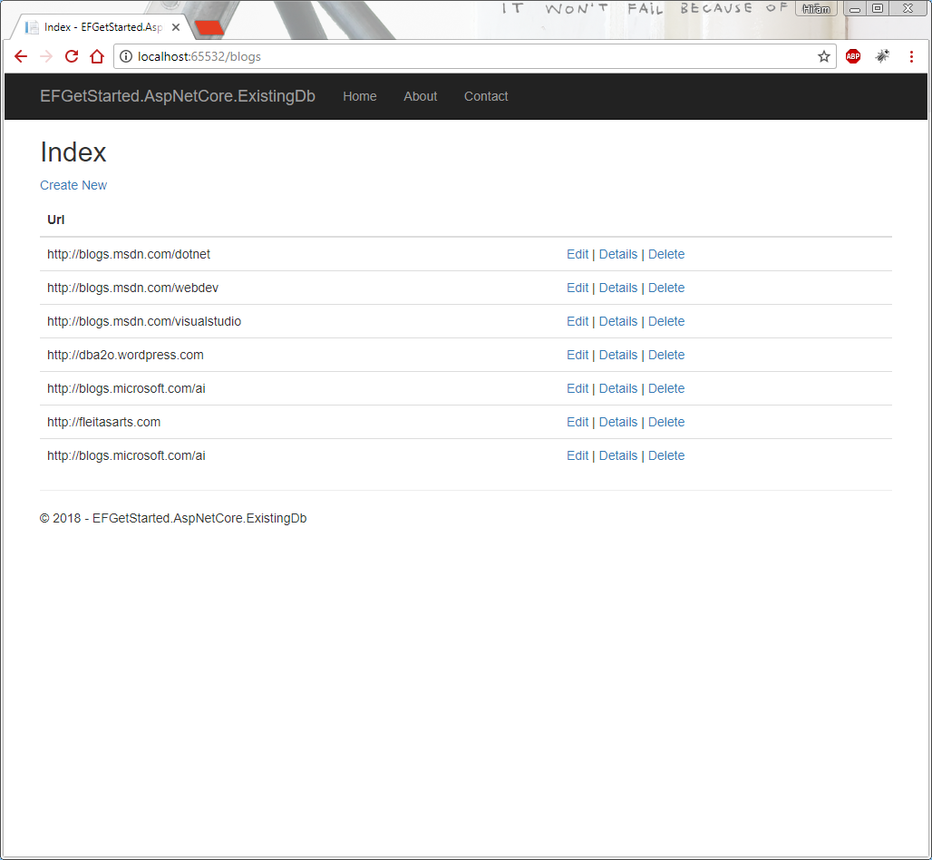
Notes:
Trollhunters MTM: (requirements: ssms, sql2008+, remote svr, vs2017 community, wireshark)
\\fldsvm_uvfile02\users$\hfleitas\SQL\PassSummit2017\20171101-1300-HackingSQLServer\TrollHunters-MITM-Demo.sql

Slide 43
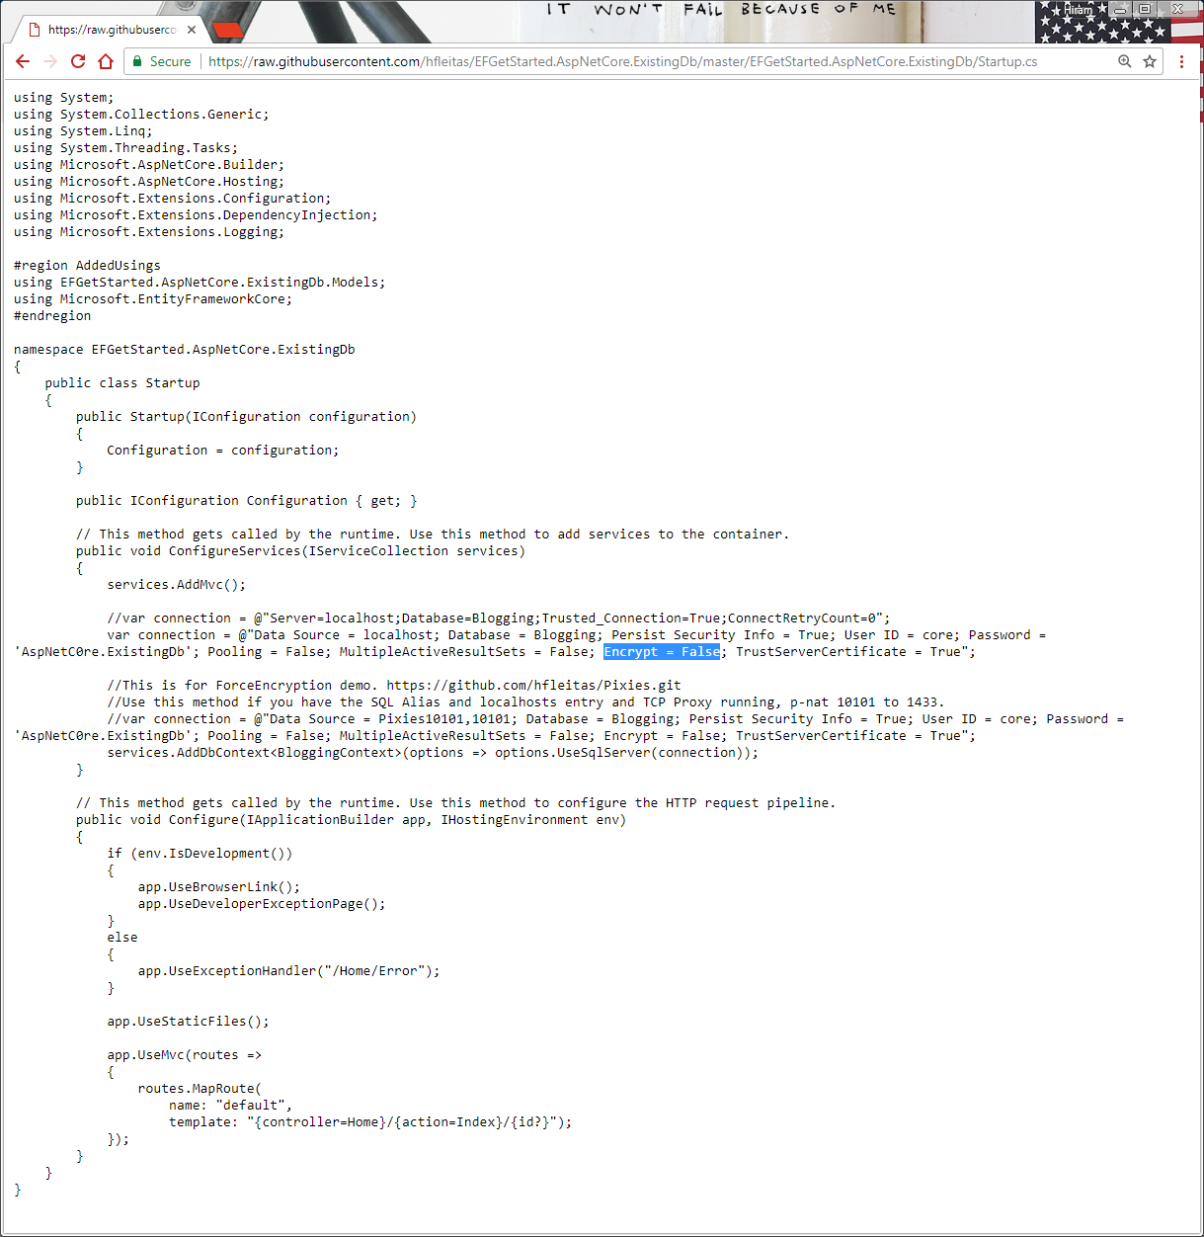
Notes:
Trollhunters MTM: (requirements: ssms, sql2008+, remote svr, vs2017 community, wireshark)
\\fldsvm_uvfile02\users$\hfleitas\SQL\PassSummit2017\20171101-1300-HackingSQLServer\TrollHunters-MITM-Demo.sql

Slide 44
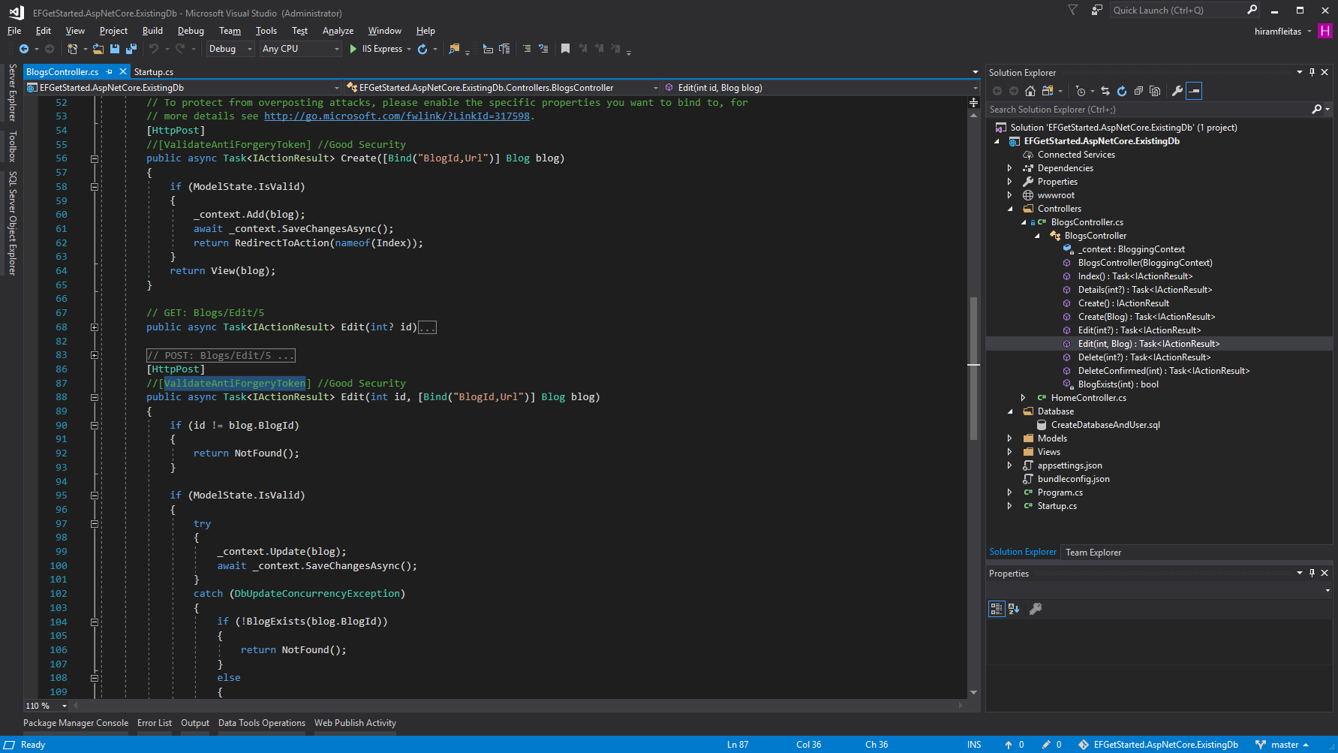
Notes:
Trollhunters MTM: (requirements: ssms, sql2008+, remote svr, vs2017 community, wireshark)
\\fldsvm_uvfile02\users$\hfleitas\SQL\PassSummit2017\20171101-1300-HackingSQLServer\TrollHunters-MITM-Demo.sql

Slide 45
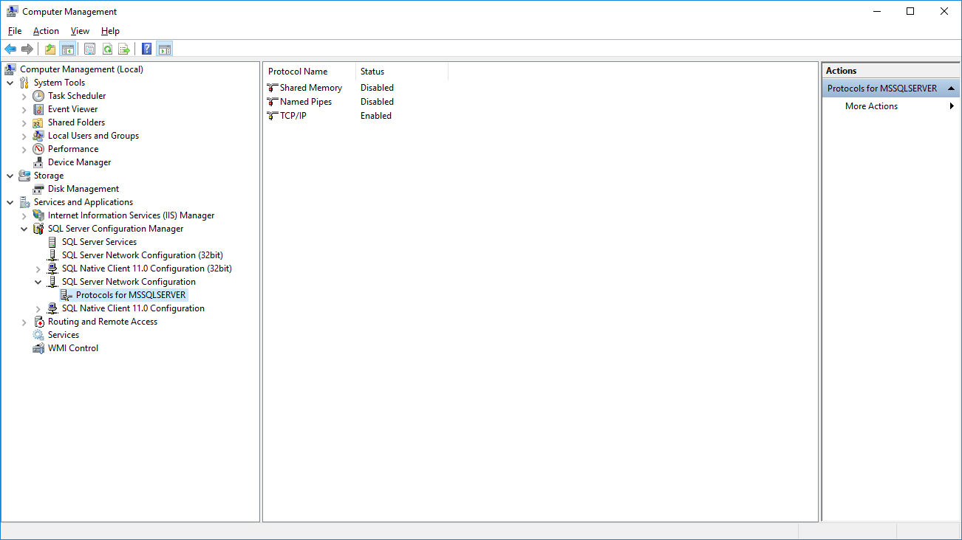

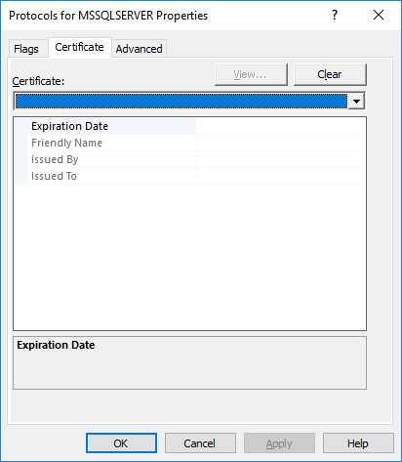
Notes:
Trollhunters MTM: (requirements: ssms, sql2008+, remote svr, vs2017 community, wireshark)
\\fldsvm_uvfile02\users$\hfleitas\SQL\PassSummit2017\20171101-1300-HackingSQLServer\TrollHunters-MITM-Demo.sql

Slide 46
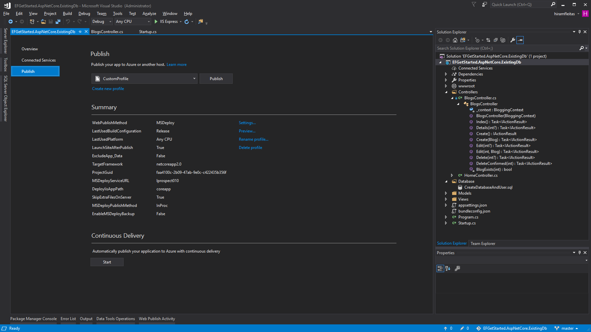
Notes:
Trollhunters MTM: (requirements: ssms, sql2008+, remote svr, vs2017 community, wireshark)
\\fldsvm_uvfile02\users$\hfleitas\SQL\PassSummit2017\20171101-1300-HackingSQLServer\TrollHunters-MITM-Demo.sql

Slide 47
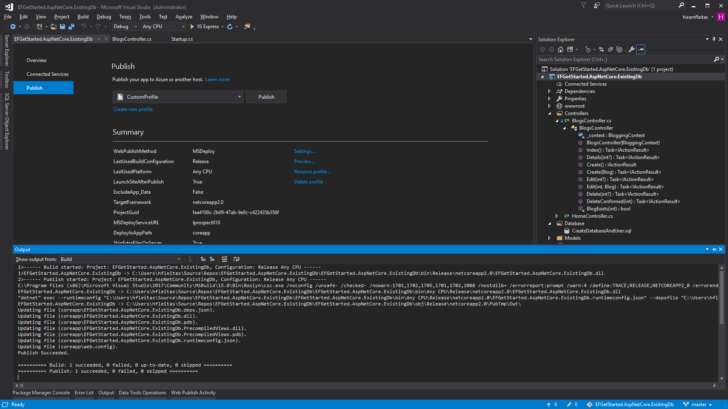
Notes:
Trollhunters MTM: (requirements: ssms, sql2008+, remote svr, vs2017 community, wireshark)
\\fldsvm_uvfile02\users$\hfleitas\SQL\PassSummit2017\20171101-1300-HackingSQLServer\TrollHunters-MITM-Demo.sql

Slide 48
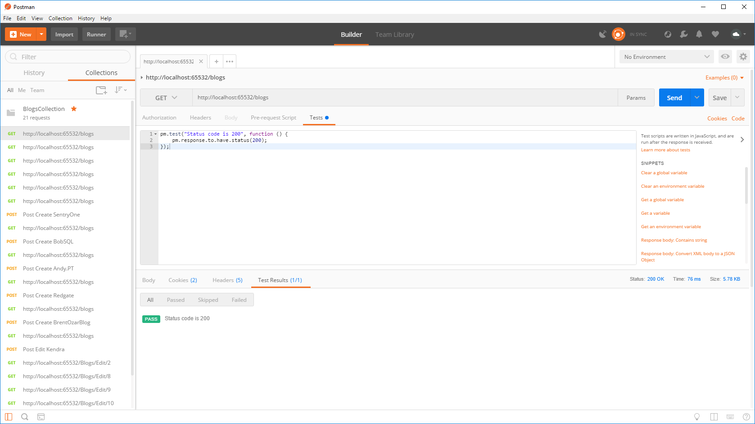
Notes:
Trollhunters MTM: (requirements: ssms, sql2008+, remote svr, vs2017 community, wireshark)
\\fldsvm_uvfile02\users$\hfleitas\SQL\PassSummit2017\20171101-1300-HackingSQLServer\TrollHunters-MITM-Demo.sql

Slide 49

Notes:
Trollhunters MTM: (requirements: ssms, sql2008+, remote svr, vs2017 community, wireshark)
\\fldsvm_uvfile02\users$\hfleitas\SQL\PassSummit2017\20171101-1300-HackingSQLServer\TrollHunters-MITM-Demo.sql

Slide 50

Notes:
Trollhunters MTM: (requirements: ssms, sql2008+, remote svr, vs2017 community, wireshark)
\\fldsvm_uvfile02\users$\hfleitas\SQL\PassSummit2017\20171101-1300-HackingSQLServer\TrollHunters-MITM-Demo.sql

Slide 51

Notes:
Trollhunters MTM: (requirements: ssms, sql2008+, remote svr, vs2017 community, wireshark)
\\fldsvm_uvfile02\users$\hfleitas\SQL\PassSummit2017\20171101-1300-HackingSQLServer\TrollHunters-MITM-Demo.sql

Slide 52

Notes:
Trollhunters MTM: (requirements: ssms, sql2008+, remote svr, vs2017 community, wireshark)
\\fldsvm_uvfile02\users$\hfleitas\SQL\PassSummit2017\20171101-1300-HackingSQLServer\TrollHunters-MITM-Demo.sql

Slide 53



Notes:
Trollhunters MTM: (requirements: ssms, sql2008+, remote svr, vs2017 community, wireshark)
\\fldsvm_uvfile02\users$\hfleitas\SQL\PassSummit2017\20171101-1300-HackingSQLServer\TrollHunters-MITM-Demo.sql

Slide 54

Notes:
Trollhunters MTM: (requirements: ssms, sql2008+, remote svr, vs2017 community, wireshark)
\\fldsvm_uvfile02\users$\hfleitas\SQL\PassSummit2017\20171101-1300-HackingSQLServer\TrollHunters-MITM-Demo.sql

Slide 55
Notes:
Trollhunters MTM: (requirements: ssms, sql2008+, remote svr, vs2017 community, wireshark)
\\fldsvm_uvfile02\users$\hfleitas\SQL\PassSummit2017\20171101-1300-HackingSQLServer\TrollHunters-MITM-Demo.sql
Ref: https://docs.microsoft.com/en-us/sql/database-engine/configure-windows/enable-encrypted-connections-to-the-database-engine
Note:
To use encryption with a failover cluster, you must install the server certificate with the fully qualified DNS name of the virtual server on all nodes in the failover cluster. For example, if you have a two-node cluster, with nodes named test1.<your company>.com and test2.<your company>.com, and you have a virtual server named virtsql, you need to install a certificate for virtsql.<your company>.com on both nodes. You can set the value of the ForceEncryptionoption to Yes.

Slide 56

Notes:
Trollhunters MTM: (requirements: ssms, sql2008+, remote svr, vs2017 community, wireshark)
\\fldsvm_uvfile02\users$\hfleitas\SQL\PassSummit2017\20171101-1300-HackingSQLServer\TrollHunters-MITM-Demo.sql

Slide 57

Notes:
Trollhunters MTM: (requirements: ssms, sql2008+, remote svr, vs2017 community, wireshark)
\\fldsvm_uvfile02\users$\hfleitas\SQL\PassSummit2017\20171101-1300-HackingSQLServer\TrollHunters-MITM-Demo.sql

Slide 58
Notes:
Ref: C:\Users\hfleitas\OneDrive\Presentations\Encryption and DB Source Control\Postman\Comparison.xlsx

Slide 59
Notes:
*4 data points out of 600 skewed results due to other processes running on the machine.
Avg was 44.62ms
Removed outliers Avg is 43.71ms
Ref: C:\Users\hfleitas\OneDrive\Presentations\Encryption and DB Source Control\Postman\Comparison.xlsx

Slide 60
DEMO 3
Dynamic Data Masking
Notes:
Columnstore Demo: (requirements: ssms, sql2016+)
H:\SQL\PassSummit2017\20171101-1100-TSQLTipsAndTricks\2017NeedToKnowAdaptiveJoinsOverRowstore\Demo
Performance 2017 vs 2016: (requirements: hammerdb, sql2016, sql2017)
HammerDB ASP02 (2016), SQL07 (2017) and if time allows do imoltp.
2017 Automatic Tuning: (requirements: perfmon, sqlcmd, ostress.exe, sql2017, wwi db)
C:\Deployments\demo3_sqlserverkeepsyoufast\
Copied ostress.exe into C:\Deployments\demo3_sqlserverkeepsyoufast (I had previously installed RML Utilities)
Replaced “.\sql2017” with “localhost” in files C:\Deployments\demo3_sqlserverkeepsyoufast\*.cmd (I had previously restored wwi on my local instance)
Edited setup.sql, replaced DROP procedure with DROP procedure if exists
PowerShell window 1:
PS ran .\report.cmd
PowerShell window 2:
PS perfom, performance monitor, added SQLServer:SQL Statistics:Batch Requests/sec.
PS .\repro_setup.cmd
PS .\initialize.cmd
PS .\auto_tune.cmd
PS .\regression.cmd
Docker: (requirements: docker, bios virtualization, git, stop mssql and iis local instances)
PS cd c:\deployments\sqldevops\docker_cluster\aks
Power BI:
https://community.powerbi.com/t5/Data-Stories-Gallery/US-Department-of-Transportation-Traffic-accident-analysis-1990/m-p/152287
C:\Deployments\PowerBI\USA-CAN TOR.pbix

Slide 61

Hack DDM

Slide 62


Slide 63


Slide 64


Slide 65


Slide 66


Slide 67


Slide 68
DEMO 4
Row Level Security
Notes:
Columnstore Demo: (requirements: ssms, sql2016+)
H:\SQL\PassSummit2017\20171101-1100-TSQLTipsAndTricks\2017NeedToKnowAdaptiveJoinsOverRowstore\Demo
Performance 2017 vs 2016: (requirements: hammerdb, sql2016, sql2017)
HammerDB ASP02 (2016), SQL07 (2017) and if time allows do imoltp.
2017 Automatic Tuning: (requirements: perfmon, sqlcmd, ostress.exe, sql2017, wwi db)
C:\Deployments\demo3_sqlserverkeepsyoufast\
Copied ostress.exe into C:\Deployments\demo3_sqlserverkeepsyoufast (I had previously installed RML Utilities)
Replaced “.\sql2017” with “localhost” in files C:\Deployments\demo3_sqlserverkeepsyoufast\*.cmd (I had previously restored wwi on my local instance)
Edited setup.sql, replaced DROP procedure with DROP procedure if exists
PowerShell window 1:
PS ran .\report.cmd
PowerShell window 2:
PS perfom, performance monitor, added SQLServer:SQL Statistics:Batch Requests/sec.
PS .\repro_setup.cmd
PS .\initialize.cmd
PS .\auto_tune.cmd
PS .\regression.cmd
Docker: (requirements: docker, bios virtualization, git, stop mssql and iis local instances)
PS cd c:\deployments\sqldevops\docker_cluster\aks
Power BI:
https://community.powerbi.com/t5/Data-Stories-Gallery/US-Department-of-Transportation-Traffic-accident-analysis-1990/m-p/152287
C:\Deployments\PowerBI\USA-CAN TOR.pbix

Slide 69

Hack RLS

Slide 71


Slide 72


Slide 73


Slide 74


Slide 75


Slide 76


Slide 77


Slide 78


Slide 79


Slide 80


Slide 81


Slide 82


Slide 83

Notes:
http://hiram/summit2017/Player.html?SID=65982
https://1drv.ms/v/s!Aq04euwkcR1Gri1eHpuMq90INzqP
See minute 47.

Slide 84


Slide 85


Slide 87
DEMO 5
Database Project
Version & Source Control
Notes:
Columnstore Demo: (requirements: ssms, sql2016+)
H:\SQL\PassSummit2017\20171101-1100-TSQLTipsAndTricks\2017NeedToKnowAdaptiveJoinsOverRowstore\Demo
Performance 2017 vs 2016: (requirements: hammerdb, sql2016, sql2017)
HammerDB ASP02 (2016), SQL07 (2017) and if time allows do imoltp.
2017 Automatic Tuning: (requirements: perfmon, sqlcmd, ostress.exe, sql2017, wwi db)
C:\Deployments\demo3_sqlserverkeepsyoufast\
Copied ostress.exe into C:\Deployments\demo3_sqlserverkeepsyoufast (I had previously installed RML Utilities)
Replaced “.\sql2017” with “localhost” in files C:\Deployments\demo3_sqlserverkeepsyoufast\*.cmd (I had previously restored wwi on my local instance)
Edited setup.sql, replaced DROP procedure with DROP procedure if exists
PowerShell window 1:
PS ran .\report.cmd
PowerShell window 2:
PS perfom, performance monitor, added SQLServer:SQL Statistics:Batch Requests/sec.
PS .\repro_setup.cmd
PS .\initialize.cmd
PS .\auto_tune.cmd
PS .\regression.cmd
Docker: (requirements: docker, bios virtualization, git, stop mssql and iis local instances)
PS cd c:\deployments\sqldevops\docker_cluster\aks
Power BI:
https://community.powerbi.com/t5/Data-Stories-Gallery/US-Department-of-Transportation-Traffic-accident-analysis-1990/m-p/152287
C:\Deployments\PowerBI\USA-CAN TOR.pbix

Slide 88

DB Source Control

Slide 89

Notes:
https://github.com/hfleitas/EFGetStarted.AspNetCore.ExistingDb
Force Encryption
TFS/SVN Database code project
VS, Create proj, import db, tfs commit, make changes outside, schema compare (update), commit.

Slide 90


Notes:
https://github.com/hfleitas/EFGetStarted.AspNetCore.ExistingDb
Force Encryption
TFS/SVN Database code project
VS, Create proj, import db, tfs commit, make changes outside, schema compare (update), commit.

Slide 91

Notes:
https://github.com/hfleitas/EFGetStarted.AspNetCore.ExistingDb
Force Encryption
TFS/SVN Database code project
VS, Create proj, import db, tfs commit, make changes outside, schema compare (update), commit.

Slide 92



Notes:
https://github.com/hfleitas/EFGetStarted.AspNetCore.ExistingDb
Force Encryption
TFS/SVN Database code project
VS, Create proj, import db, tfs commit, make changes outside, schema compare (update), commit.

Slide 93

Notes:
https://github.com/hfleitas/EFGetStarted.AspNetCore.ExistingDb
Force Encryption
TFS/SVN Database code project
VS, Create proj, import db, tfs commit, make changes outside, schema compare (update), commit.

Slide 94


Notes:
https://github.com/hfleitas/EFGetStarted.AspNetCore.ExistingDb
Force Encryption
TFS/SVN Database code project
VS, Create proj, import db, tfs commit, make changes outside, schema compare (update), commit.

Slide 95

Notes:
https://github.com/hfleitas/EFGetStarted.AspNetCore.ExistingDb
Force Encryption
TFS/SVN Database code project
VS, Create proj, import db, tfs commit, make changes outside, schema compare (update), commit.

Slide 96
TFS
Section
Notes:
Columnstore Demo: (requirements: ssms, sql2016+)
H:\SQL\PassSummit2017\20171101-1100-TSQLTipsAndTricks\2017NeedToKnowAdaptiveJoinsOverRowstore\Demo
Performance 2017 vs 2016: (requirements: hammerdb, sql2016, sql2017)
HammerDB ASP02 (2016), SQL07 (2017) and if time allows do imoltp.
2017 Automatic Tuning: (requirements: perfmon, sqlcmd, ostress.exe, sql2017, wwi db)
C:\Deployments\demo3_sqlserverkeepsyoufast\
Copied ostress.exe into C:\Deployments\demo3_sqlserverkeepsyoufast (I had previously installed RML Utilities)
Replaced “.\sql2017” with “localhost” in files C:\Deployments\demo3_sqlserverkeepsyoufast\*.cmd (I had previously restored wwi on my local instance)
Edited setup.sql, replaced DROP procedure with DROP procedure if exists
PowerShell window 1:
PS ran .\report.cmd
PowerShell window 2:
PS perfom, performance monitor, added SQLServer:SQL Statistics:Batch Requests/sec.
PS .\repro_setup.cmd
PS .\initialize.cmd
PS .\auto_tune.cmd
PS .\regression.cmd
Docker: (requirements: docker, bios virtualization, git, stop mssql and iis local instances)
PS cd c:\deployments\sqldevops\docker_cluster\aks
Power BI:
https://community.powerbi.com/t5/Data-Stories-Gallery/US-Department-of-Transportation-Traffic-accident-analysis-1990/m-p/152287
C:\Deployments\PowerBI\USA-CAN TOR.pbix

Slide 97




Notes:
https://github.com/hfleitas/EFGetStarted.AspNetCore.ExistingDb
Force Encryption
TFS/SVN Database code project
VS, Create proj, import db, tfs commit, make changes outside, schema compare (update), commit.

Slide 98

Notes:
https://github.com/hfleitas/EFGetStarted.AspNetCore.ExistingDb
Force Encryption
TFS/SVN Database code project
VS, Create proj, import db, tfs commit, make changes outside, schema compare (update), commit.

Slide 99


Notes:
https://github.com/hfleitas/EFGetStarted.AspNetCore.ExistingDb
Force Encryption
TFS/SVN Database code project
VS, Create proj, import db, tfs commit, make changes outside, schema compare (update), commit.

Slide 100

Notes:
https://github.com/hfleitas/EFGetStarted.AspNetCore.ExistingDb
Force Encryption
TFS/SVN Database code project
VS, Create proj, import db, tfs commit, make changes outside, schema compare (update), commit.

Slide 101

Notes:
https://github.com/hfleitas/EFGetStarted.AspNetCore.ExistingDb
Force Encryption
TFS/SVN Database code project
VS, Create proj, import db, tfs commit, make changes outside, schema compare (update), commit.

Slide 102

Notes:
https://github.com/hfleitas/EFGetStarted.AspNetCore.ExistingDb
Force Encryption
TFS/SVN Database code project
VS, Create proj, import db, tfs commit, make changes outside, schema compare (update), commit.

Slide 103

Notes:
https://github.com/hfleitas/EFGetStarted.AspNetCore.ExistingDb
Force Encryption
TFS/SVN Database code project
VS, Create proj, import db, tfs commit, make changes outside, schema compare (update), commit.

Slide 104

Notes:
https://github.com/hfleitas/EFGetStarted.AspNetCore.ExistingDb
Force Encryption
TFS/SVN Database code project
VS, Create proj, import db, tfs commit, make changes outside, schema compare (update), commit.

Slide 105

Notes:
https://github.com/hfleitas/EFGetStarted.AspNetCore.ExistingDb
Force Encryption
TFS/SVN Database code project
VS, Create proj, import db, tfs commit, make changes outside, schema compare (update), commit.

Slide 106



Notes:
https://github.com/hfleitas/EFGetStarted.AspNetCore.ExistingDb
Force Encryption
TFS/SVN Database code project
VS, Create proj, import db, tfs commit, make changes outside, schema compare (update), commit.

Slide 107



Notes:
https://github.com/hfleitas/EFGetStarted.AspNetCore.ExistingDb
Force Encryption
TFS/SVN Database code project
VS, Create proj, import db, tfs commit, make changes outside, schema compare (update), commit.

Slide 108

Notes:
https://github.com/hfleitas/EFGetStarted.AspNetCore.ExistingDb
Force Encryption
TFS/SVN Database code project
VS, Create proj, import db, tfs commit, make changes outside, schema compare (update), commit.

Slide 109

Notes:
https://github.com/hfleitas/EFGetStarted.AspNetCore.ExistingDb
Force Encryption
TFS/SVN Database code project
VS, Create proj, import db, tfs commit, make changes outside, schema compare (update), commit.

Slide 110

Notes:
https://github.com/hfleitas/EFGetStarted.AspNetCore.ExistingDb
Force Encryption
TFS/SVN Database code project
VS, Create proj, import db, tfs commit, make changes outside, schema compare (update), commit.

Slide 111

Notes:
https://github.com/hfleitas/EFGetStarted.AspNetCore.ExistingDb
Force Encryption
TFS/SVN Database code project
VS, Create proj, import db, tfs commit, make changes outside, schema compare (update), commit.

Slide 112

Notes:
https://github.com/hfleitas/EFGetStarted.AspNetCore.ExistingDb
Force Encryption
TFS/SVN Database code project
VS, Create proj, import db, tfs commit, make changes outside, schema compare (update), commit.

Slide 113

Notes:
https://github.com/hfleitas/EFGetStarted.AspNetCore.ExistingDb
Force Encryption
TFS/SVN Database code project
VS, Create proj, import db, tfs commit, make changes outside, schema compare (update), commit.

Slide 114

Notes:
https://github.com/hfleitas/EFGetStarted.AspNetCore.ExistingDb
Force Encryption
TFS/SVN Database code project
VS, Create proj, import db, tfs commit, make changes outside, schema compare (update), commit.

Slide 115

Notes:
https://github.com/hfleitas/EFGetStarted.AspNetCore.ExistingDb
Force Encryption
TFS/SVN Database code project
VS, Create proj, import db, tfs commit, make changes outside, schema compare (update), commit.

Slide 116

Notes:
https://github.com/hfleitas/EFGetStarted.AspNetCore.ExistingDb
Force Encryption
TFS/SVN Database code project
VS, Create proj, import db, tfs commit, make changes outside, schema compare (update), commit.

Slide 117

Notes:
https://github.com/hfleitas/EFGetStarted.AspNetCore.ExistingDb
Force Encryption
TFS/SVN Database code project
VS, Create proj, import db, tfs commit, make changes outside, schema compare (update), commit.

Slide 118

Notes:
https://github.com/hfleitas/EFGetStarted.AspNetCore.ExistingDb
Force Encryption
TFS/SVN Database code project
VS, Create proj, import db, tfs commit, make changes outside, schema compare (update), commit.

Slide 119


Notes:
https://github.com/hfleitas/EFGetStarted.AspNetCore.ExistingDb
Force Encryption
TFS/SVN Database code project
VS, Create proj, import db, tfs commit, make changes outside, schema compare (update), commit.

Slide 120

Notes:
https://github.com/hfleitas/EFGetStarted.AspNetCore.ExistingDb
Force Encryption
TFS/SVN Database code project
VS, Create proj, import db, tfs commit, make changes outside, schema compare (update), commit.

Slide 121

Notes:
https://github.com/hfleitas/EFGetStarted.AspNetCore.ExistingDb
Force Encryption
TFS/SVN Database code project
VS, Create proj, import db, tfs commit, make changes outside, schema compare (update), commit.

Slide 122

Notes:
https://github.com/hfleitas/EFGetStarted.AspNetCore.ExistingDb
Force Encryption
TFS/SVN Database code project
VS, Create proj, import db, tfs commit, make changes outside, schema compare (update), commit.

Slide 123
GitHub
Section
Notes:
Columnstore Demo: (requirements: ssms, sql2016+)
H:\SQL\PassSummit2017\20171101-1100-TSQLTipsAndTricks\2017NeedToKnowAdaptiveJoinsOverRowstore\Demo
Performance 2017 vs 2016: (requirements: hammerdb, sql2016, sql2017)
HammerDB ASP02 (2016), SQL07 (2017) and if time allows do imoltp.
2017 Automatic Tuning: (requirements: perfmon, sqlcmd, ostress.exe, sql2017, wwi db)
C:\Deployments\demo3_sqlserverkeepsyoufast\
Copied ostress.exe into C:\Deployments\demo3_sqlserverkeepsyoufast (I had previously installed RML Utilities)
Replaced “.\sql2017” with “localhost” in files C:\Deployments\demo3_sqlserverkeepsyoufast\*.cmd (I had previously restored wwi on my local instance)
Edited setup.sql, replaced DROP procedure with DROP procedure if exists
PowerShell window 1:
PS ran .\report.cmd
PowerShell window 2:
PS perfom, performance monitor, added SQLServer:SQL Statistics:Batch Requests/sec.
PS .\repro_setup.cmd
PS .\initialize.cmd
PS .\auto_tune.cmd
PS .\regression.cmd
Docker: (requirements: docker, bios virtualization, git, stop mssql and iis local instances)
PS cd c:\deployments\sqldevops\docker_cluster\aks
Power BI:
https://community.powerbi.com/t5/Data-Stories-Gallery/US-Department-of-Transportation-Traffic-accident-analysis-1990/m-p/152287
C:\Deployments\PowerBI\USA-CAN TOR.pbix

Slide 124
Notes:
https://github.com/hfleitas/EFGetStarted.AspNetCore.ExistingDb
Force Encryption
TFS/SVN Database code project
VS, Create proj, import db, tfs commit, make changes outside, schema compare (update), commit.

Slide 125

Notes:
https://github.com/hfleitas/EFGetStarted.AspNetCore.ExistingDb
Force Encryption
TFS/SVN Database code project
VS, Create proj, import db, tfs commit, make changes outside, schema compare (update), commit.

Slide 126

Notes:
https://github.com/hfleitas/EFGetStarted.AspNetCore.ExistingDb
Force Encryption
TFS/SVN Database code project
VS, Create proj, import db, tfs commit, make changes outside, schema compare (update), commit.

Slide 127

Notes:
https://github.com/hfleitas/EFGetStarted.AspNetCore.ExistingDb
Force Encryption
TFS/SVN Database code project
VS, Create proj, import db, tfs commit, make changes outside, schema compare (update), commit.

Slide 128

Notes:
https://github.com/hfleitas/EFGetStarted.AspNetCore.ExistingDb
Force Encryption
TFS/SVN Database code project
VS, Create proj, import db, tfs commit, make changes outside, schema compare (update), commit.

Slide 129

Notes:
https://github.com/hfleitas/EFGetStarted.AspNetCore.ExistingDb
Force Encryption
TFS/SVN Database code project
VS, Create proj, import db, tfs commit, make changes outside, schema compare (update), commit.

Slide 130

Notes:
https://github.com/hfleitas/EFGetStarted.AspNetCore.ExistingDb
Force Encryption
TFS/SVN Database code project
VS, Create proj, import db, tfs commit, make changes outside, schema compare (update), commit.

Slide 131

Notes:
https://github.com/hfleitas/EFGetStarted.AspNetCore.ExistingDb
Force Encryption
TFS/SVN Database code project
VS, Create proj, import db, tfs commit, make changes outside, schema compare (update), commit.

Slide 132

Notes:
https://github.com/hfleitas/EFGetStarted.AspNetCore.ExistingDb
Force Encryption
TFS/SVN Database code project
VS, Create proj, import db, tfs commit, make changes outside, schema compare (update), commit.

Slide 133

Notes:
https://github.com/hfleitas/EFGetStarted.AspNetCore.ExistingDb
Force Encryption
TFS/SVN Database code project
VS, Create proj, import db, tfs commit, make changes outside, schema compare (update), commit.

Slide 134

Notes:
https://github.com/hfleitas/EFGetStarted.AspNetCore.ExistingDb
Force Encryption
TFS/SVN Database code project
VS, Create proj, import db, tfs commit, make changes outside, schema compare (update), commit.

Slide 135

Notes:
https://github.com/hfleitas/EFGetStarted.AspNetCore.ExistingDb
Force Encryption
TFS/SVN Database code project
VS, Create proj, import db, tfs commit, make changes outside, schema compare (update), commit.

Slide 136

Notes:
https://github.com/hfleitas/EFGetStarted.AspNetCore.ExistingDb
Force Encryption
TFS/SVN Database code project
VS, Create proj, import db, tfs commit, make changes outside, schema compare (update), commit.

Slide 137

Notes:
https://github.com/hfleitas/EFGetStarted.AspNetCore.ExistingDb
Force Encryption
TFS/SVN Database code project
VS, Create proj, import db, tfs commit, make changes outside, schema compare (update), commit.

Slide 138

Notes:
https://github.com/hfleitas/EFGetStarted.AspNetCore.ExistingDb
Force Encryption
TFS/SVN Database code project
VS, Create proj, import db, tfs commit, make changes outside, schema compare (update), commit.

Slide 139

Notes:
https://github.com/hfleitas/EFGetStarted.AspNetCore.ExistingDb
Force Encryption
TFS/SVN Database code project
VS, Create proj, import db, tfs commit, make changes outside, schema compare (update), commit.

Slide 140
Notes:
https://github.com/hfleitas/EFGetStarted.AspNetCore.ExistingDb
Force Encryption
TFS/SVN Database code project
VS, Create proj, import db, tfs commit, make changes outside, schema compare (update), commit.

Slide 141
DEMO 6
SQL Server
Machine Learning & AI
Notes:
Columnstore Demo: (requirements: ssms, sql2016+)
H:\SQL\PassSummit2017\20171101-1100-TSQLTipsAndTricks\2017NeedToKnowAdaptiveJoinsOverRowstore\Demo
Performance 2017 vs 2016: (requirements: hammerdb, sql2016, sql2017)
HammerDB ASP02 (2016), SQL07 (2017) and if time allows do imoltp.
2017 Automatic Tuning: (requirements: perfmon, sqlcmd, ostress.exe, sql2017, wwi db)
C:\Deployments\demo3_sqlserverkeepsyoufast\
Copied ostress.exe into C:\Deployments\demo3_sqlserverkeepsyoufast (I had previously installed RML Utilities)
Replaced “.\sql2017” with “localhost” in files C:\Deployments\demo3_sqlserverkeepsyoufast\*.cmd (I had previously restored wwi on my local instance)
Edited setup.sql, replaced DROP procedure with DROP procedure if exists
PowerShell window 1:
PS ran .\report.cmd
PowerShell window 2:
PS perfom, performance monitor, added SQLServer:SQL Statistics:Batch Requests/sec.
PS .\repro_setup.cmd
PS .\initialize.cmd
PS .\auto_tune.cmd
PS .\regression.cmd
Docker: (requirements: docker, bios virtualization, git, stop mssql and iis local instances)
PS cd c:\deployments\sqldevops\docker_cluster\aks
Power BI:
https://community.powerbi.com/t5/Data-Stories-Gallery/US-Department-of-Transportation-Traffic-accident-analysis-1990/m-p/152287
C:\Deployments\PowerBI\USA-CAN TOR.pbix

Slide 142

SQL ML / AI

Slide 143


Notes:
https://www.netflix.com/title/80075820

Slide 144


Slide 145



Slide 146

Not in 2019ctp2

Slide 147



2017
2019ctp2

Slide 148


Slide 149


2017
2019ctp2

Slide 150

2019ctp2

Slide 151

2017

Slide 152

2019ctp2

Slide 153


Slide 154


Slide 155



Slide 156


Slide 157


Slide 158



Slide 159


Slide 160


Slide 161


Slide 162


Slide 163


Slide 164


Slide 165



Slide 166


Slide 167


Slide 168



Slide 169


Slide 170



Slide 171


Slide 172


Slide 173


Slide 174


Slide 177


Resources
Hiram Fleitas
Tues, Oct 30
6 - 9 PM
DBA Advanced
Slides, Scripts, Recordings, Notes:
Public: https://goo.gl/BqfYSi
Best of Summit: Best of 2017
PASStv: http://pass.org/summit/2017/PASStv.aspx
Keynote Day 1: https://youtu.be/NGbk9XGWTHI
Microsoft BI - An Integrated Modern Solution: https://youtu.be/T0If-SNl08A
Keynote Day 2: https://youtu.be/7SRi9vyDtWY
Keynote Day 3 (WIT): https://youtu.be/8JnXi0gnTb8
Speakers: 2018
Bob Ward’s slides & scripts: http://aka.ms/bobwardms
Performance: Adaptive Query Processing, Automatic Tuning.
Docker: Quickstart
Docker SQL, App, CI/CD: Channel9
Postman: Get Postman
SSDT: Download SQL Server Data Tools
TFS Pricing: https://visualstudio.com/team-services/tfs-pricing
GitHub Pricing: https://github.com/pricing
The Roadmap for SQL Server 2019: MSSQL Tiger Team Playlist
Pre-Trained Deep Neural Network Models: Image Featurization
More:
@sqlpass, #PASSSummit, #powerbihelp, #sqlhelp, @MSPowerBI, @mssqltiger
Join Slack workspace: http://dbatools.io/slack
Slack channels: #dbatools, #firstresponderkit, #general, #pass-summit, #query-tuning, #sqlhelp, #git-help
Pass Virtual Groups: Community Groups (App Dev, BI, DBA, DevOps, Global Spanish, HA/DR, Performance, PowerShell, Virtualization, Linux)
More webinars: Channel9, GroupBy, SQLWorkBooks
Microsoft AI: AI School Learning Paths
Models: Install pre-trained Machine Learning models on SQL Server
Tutorials: Get Started with SQL Server Machine Learning Services
Interaction of Components: SQL Server Components to Support Python
Threading ML: Logistic Regression
Resource Governor: Alter External Resource Pool
Product Reviews Dataset: Amazon Customer Reviews Dataset
Spyder IDE: Download Spyder with Anaconda (631MB)
VSCode: Download (43 MB)
Visual Studio: Downloads

Slide 178



Session evaluations Your feedback is important and valuable.
goo.gl/QEkoDi
Submit your feedback by the end of this session to win a prize.
goo.gl/QEkoDi
http://hiram/evals

Slide 179

Sponsor
Notes:
Performance 2017 vs 2016: (requirements: hammerdb, sql2016, sql2017)
HammerDB ASP02 (2016), SQL07 (2017) and if time allows do imoltp.

Slide 180



Thank You Hit me up!
/HiramFleitas
/hfleitas
@HiramFleitas
hiramfleitas@hotmail.com
HiramFleitas
dba2o.wordpress.com

